Slide 1

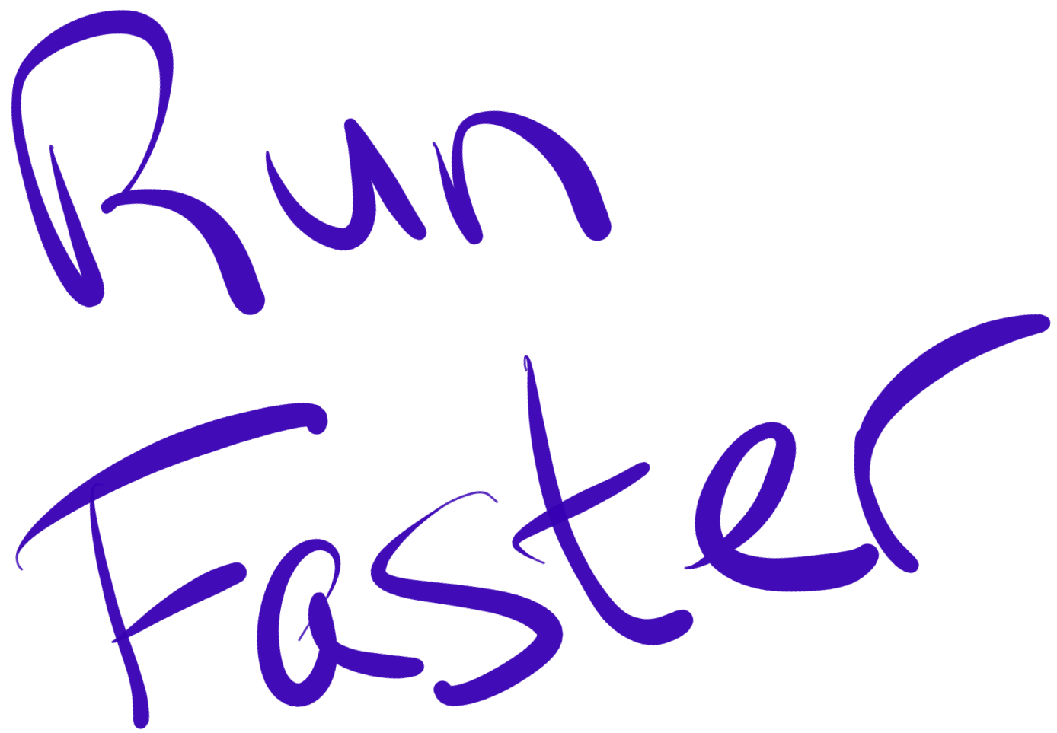

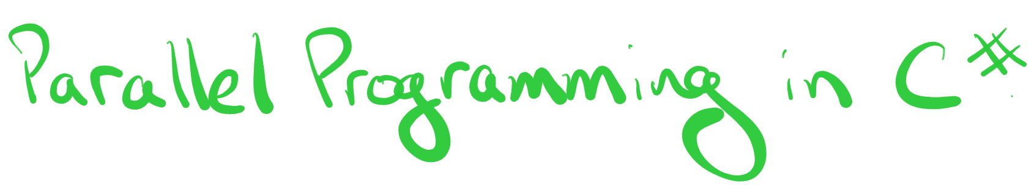
@jeremybytes
Notes:
Run Faster: Parallel Programming in C#
Presented by Jeremy Clark
Twitter @jeremybytes

Slide 2







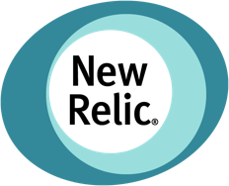






































Titanium Sponsors
Platinum Sponsors
Gold Sponsors

Slide 3
@jeremybytes
Notes:
Run Faster: Parallel Programming in C#
Presented by Jeremy Clark
Twitter @jeremybytes

Slide 4

@jeremybytes
Notes:
What are we talking about today?

Slide 5
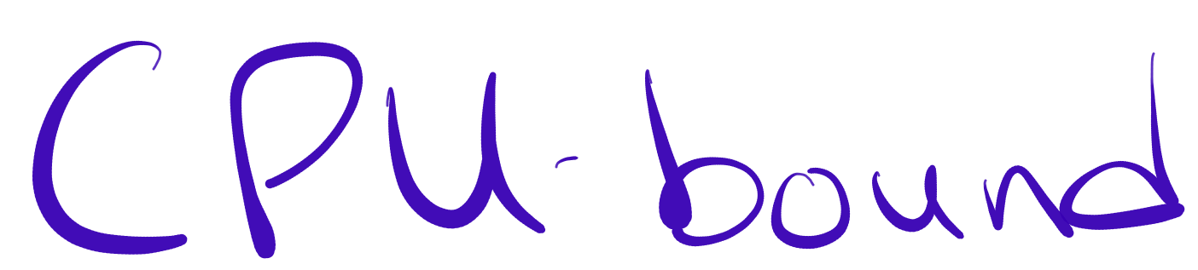

@jeremybytes
Notes:
CPU-bound operations

Slide 6
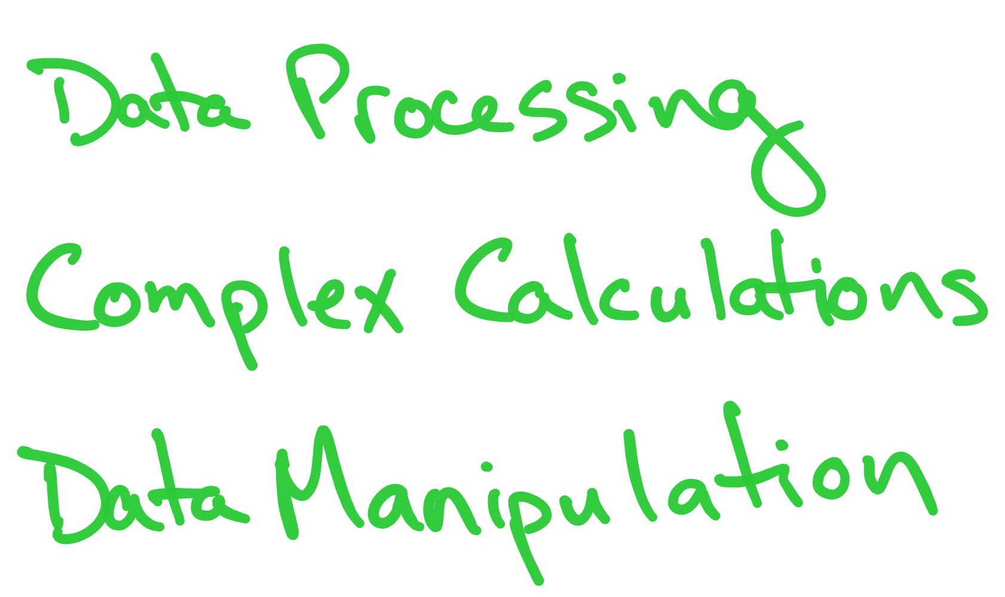
@jeremybytes
Notes:
CPU-bound operations are things like
Data processing
Complex calculations
And Data manipulation

Slide 7

@jeremybytes
Notes:
Why do we need to worry about parallel programming?

Slide 8



@jeremybytes
Notes:
CPUs are getting bigger, not faster

Slide 9

@jeremybytes
Notes:
Single-core CPU

Slide 10
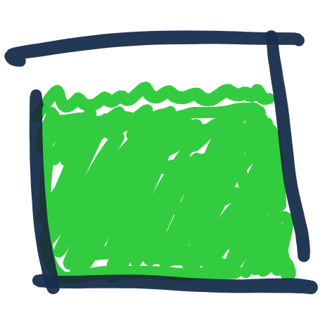
@jeremybytes
Notes:
Single-core CPU at full load

Slide 11
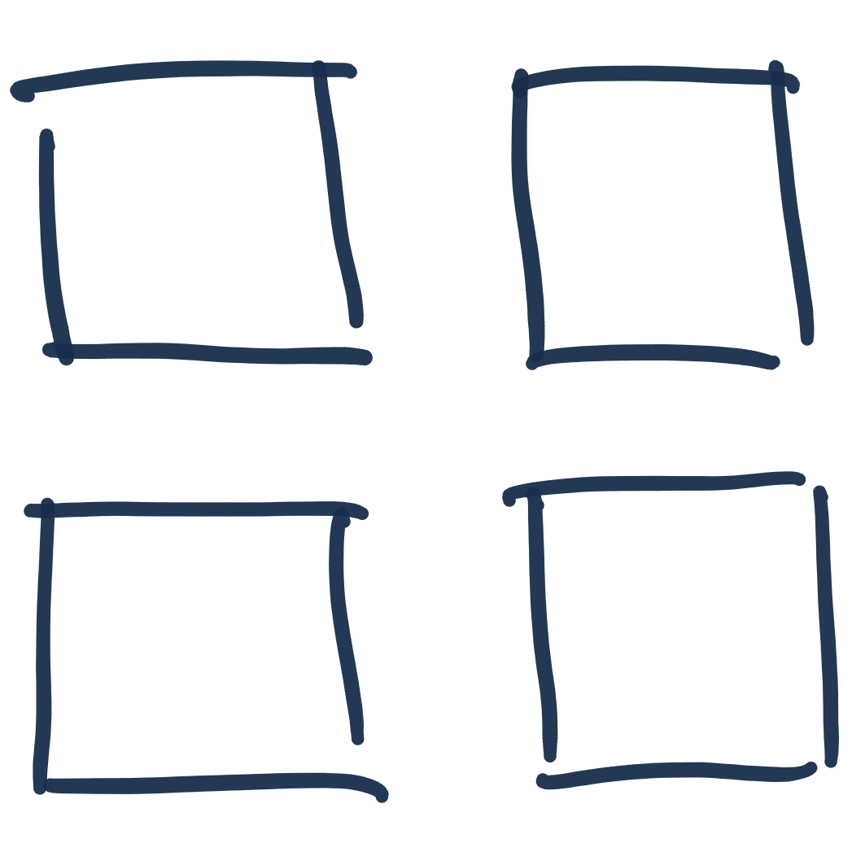
@jeremybytes
Notes:
4-core CPU

Slide 12
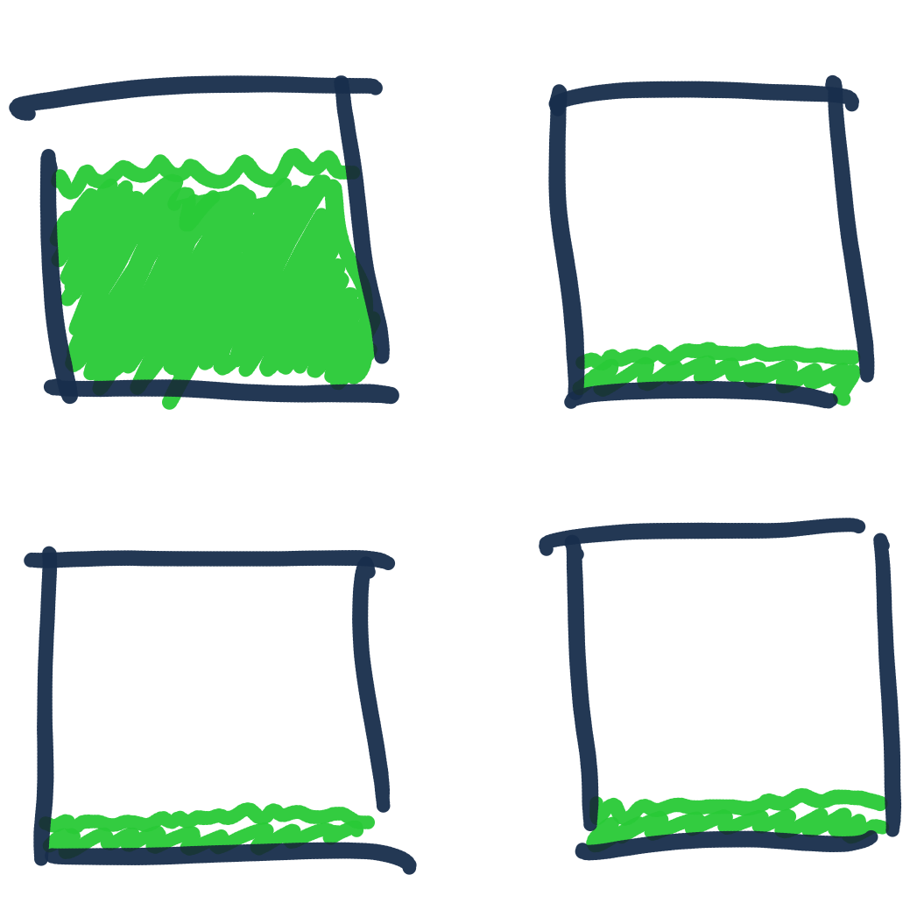
@jeremybytes
Notes:
4-core CPU with one core at full load and 3 cores at minimal load

Slide 13
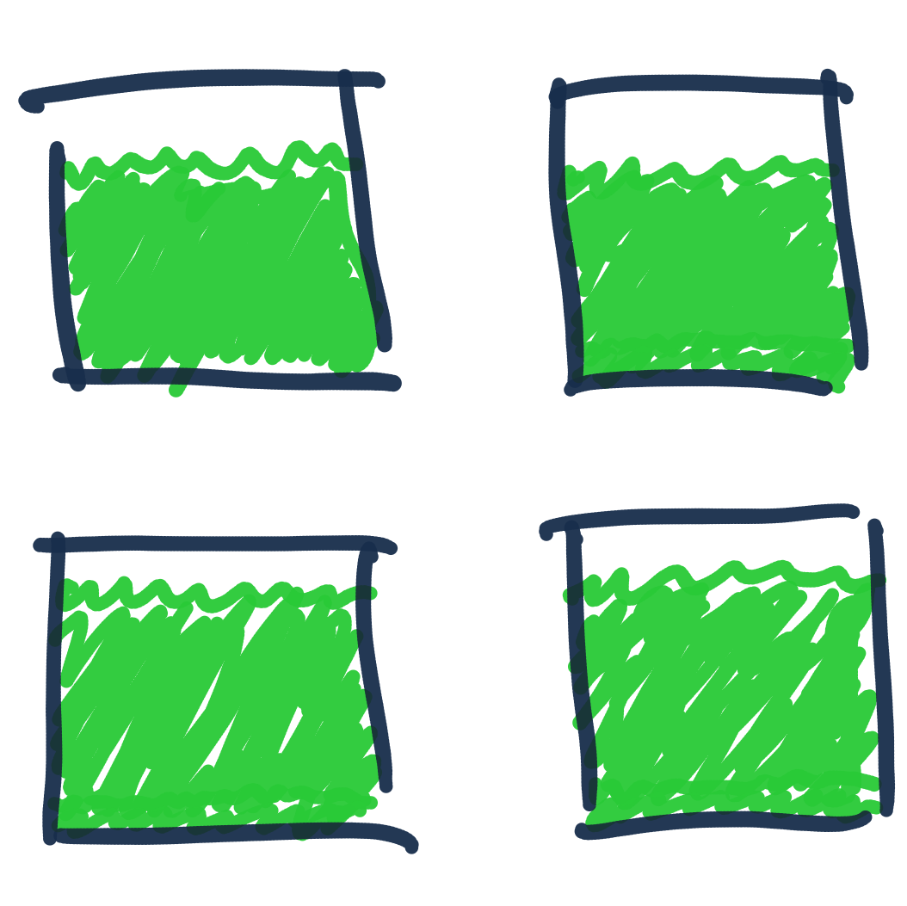
@jeremybytes
Notes:
4-core CPU with 4 cores at full load

Slide 14
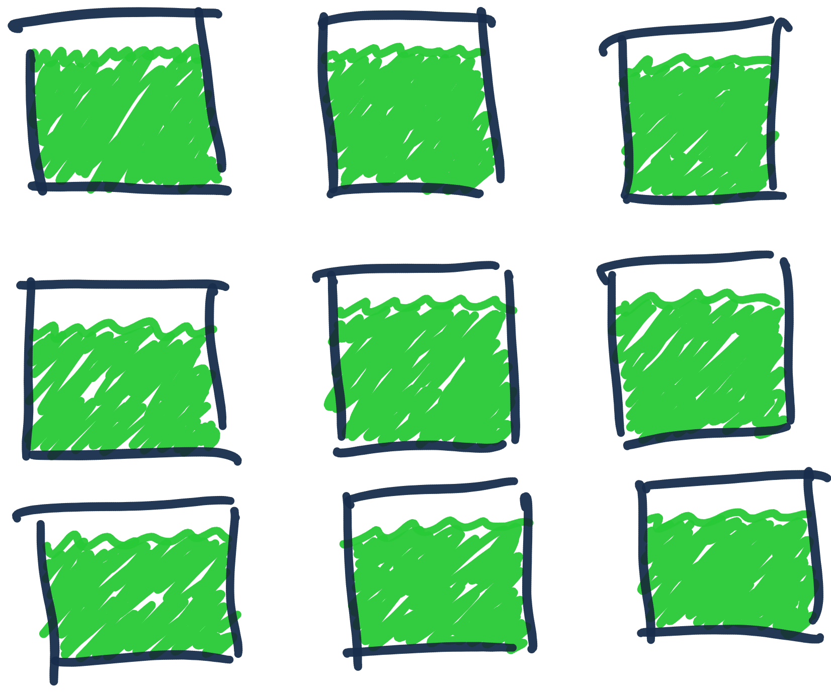
@jeremybytes
Notes:
18-core CPU at full load

Slide 15


@jeremybytes
Notes:
Can I run my code in parallel?

Slide 16


@jeremybytes
Notes:
Maybe
Maybe not

Slide 17
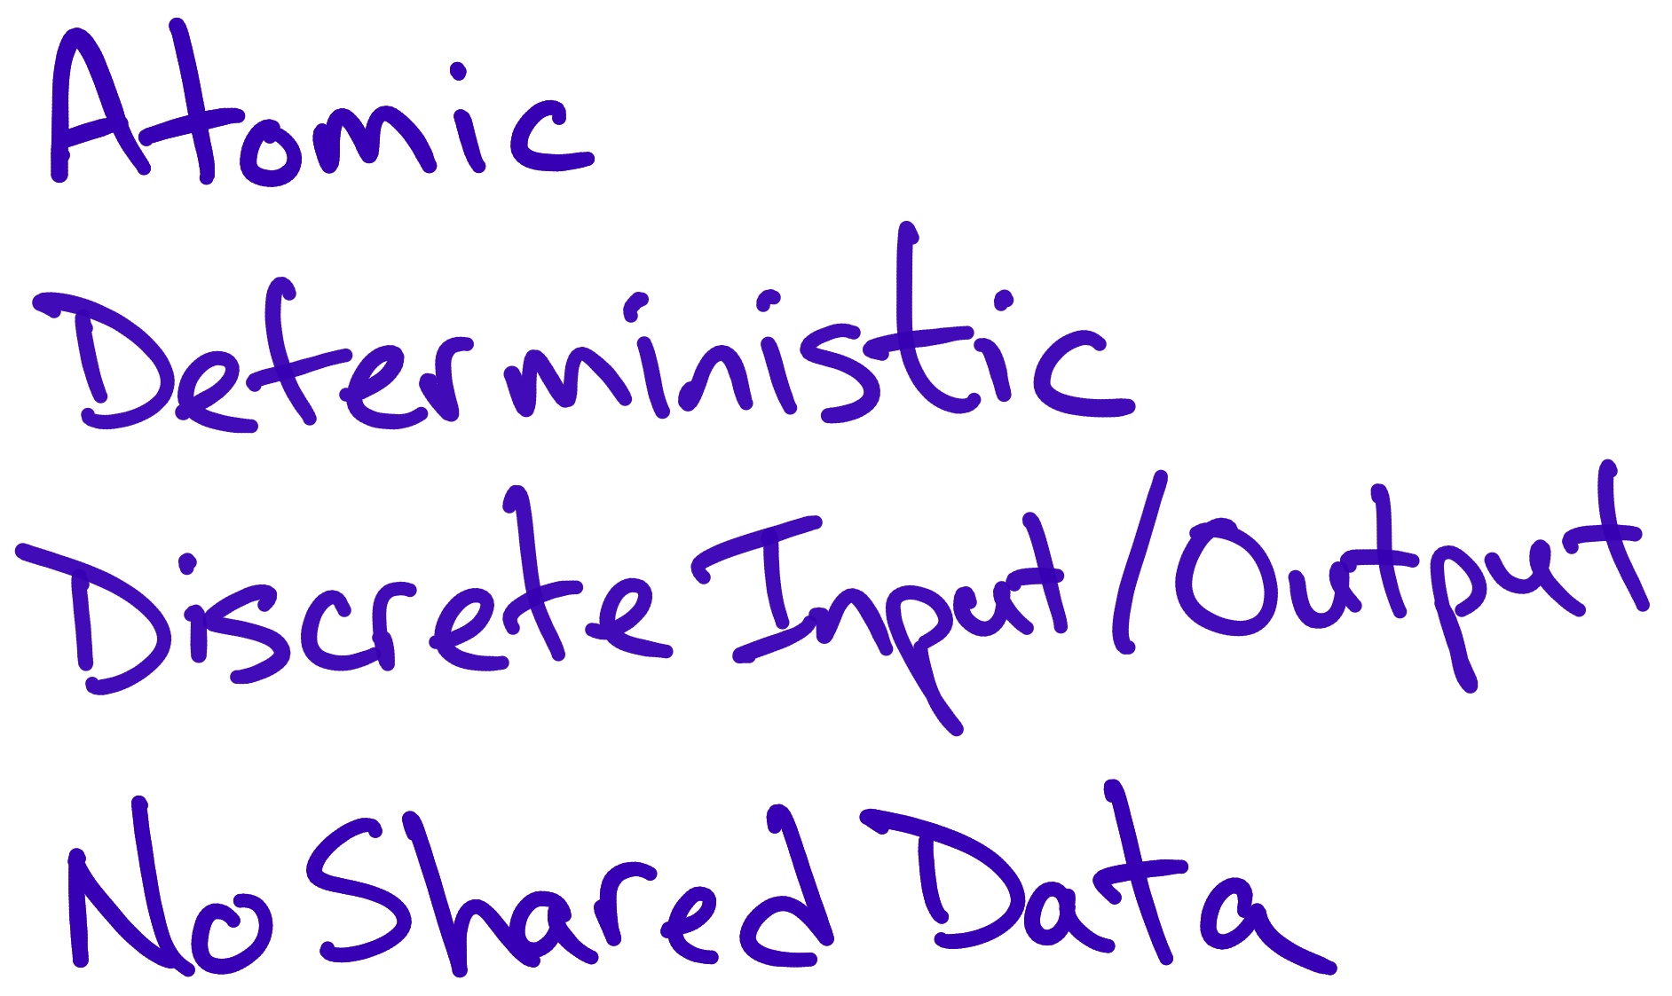
@jeremybytes
Notes:
Maybe parallel code characteristics, i.e. code that is easier to run in parallel.
Atomic
Deterministic
Discrete input and output
No shared data

Slide 18
@jeremybytes
Notes:
Maybe not

Slide 19
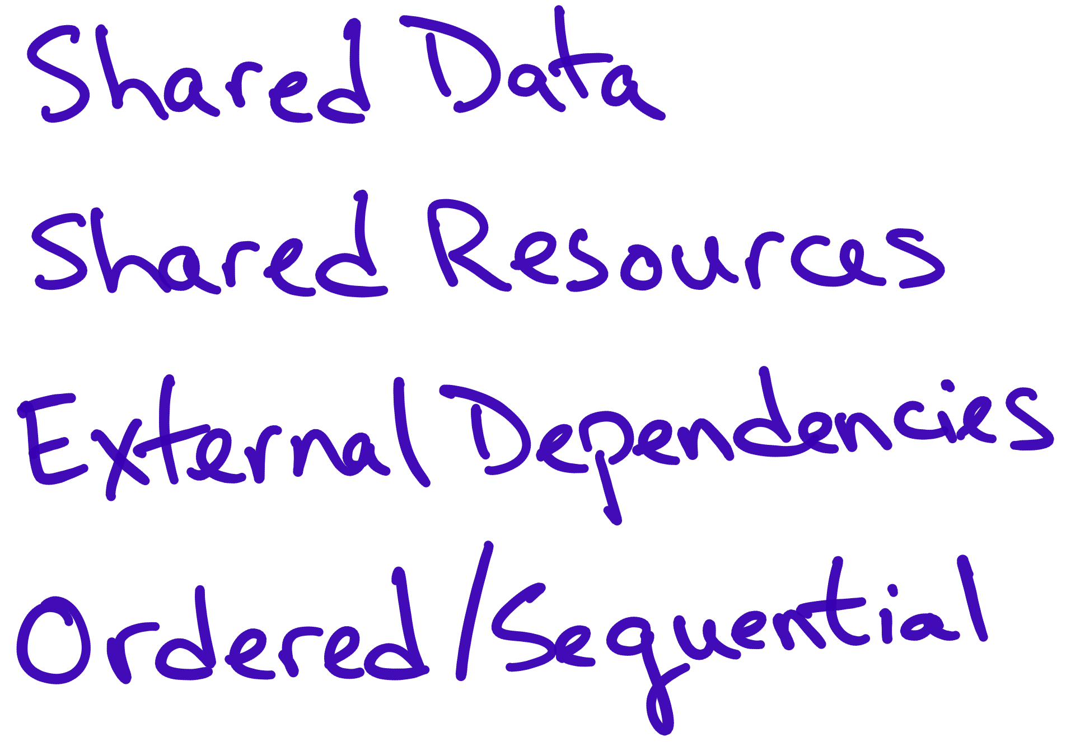
@jeremybytes
Notes:
Maybe not parallel characteristics, i.e. code that is difficult to run parallel.
Shared data
Shared resources
External dependencies
Ordered or sequential operations

Slide 20
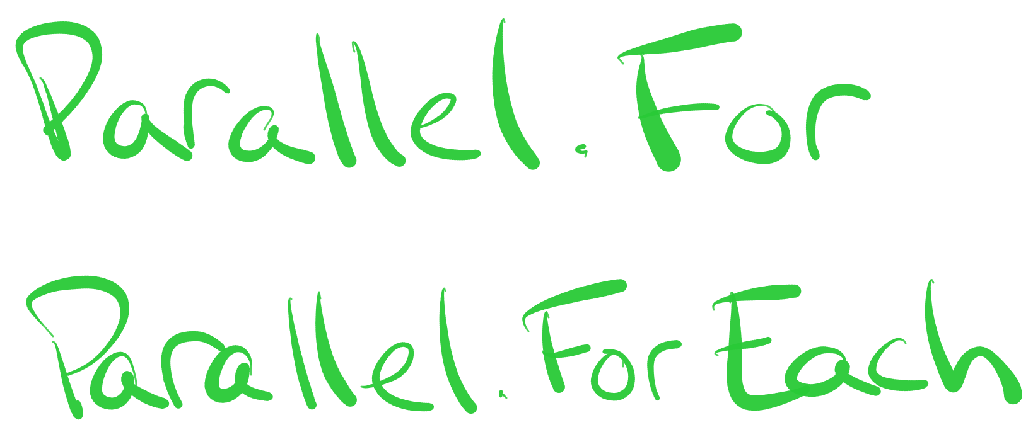
@jeremybytes
Notes:
Parallel.For and Parallel.ForEach

Slide 21

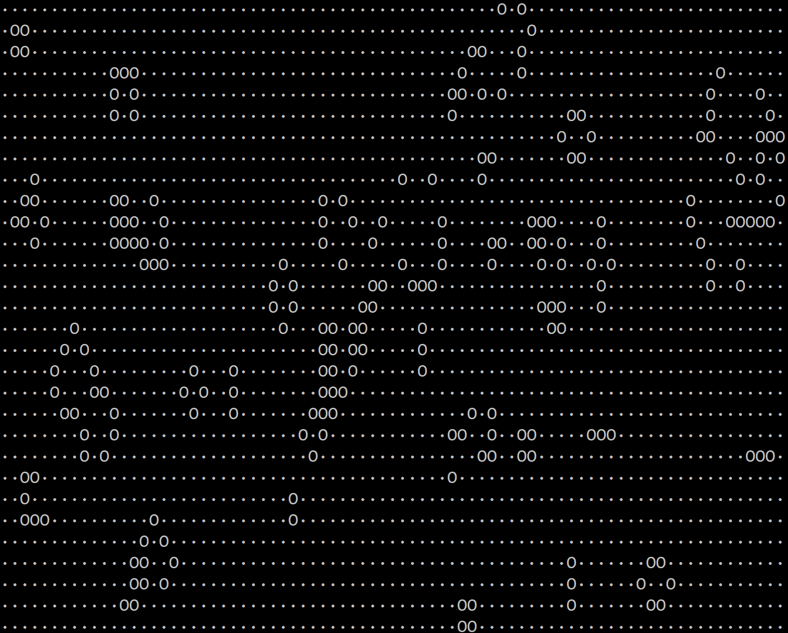


@jeremybytes
Notes:
Example application using Parallel.ForEach
Conway's Game of Life

Slide 22
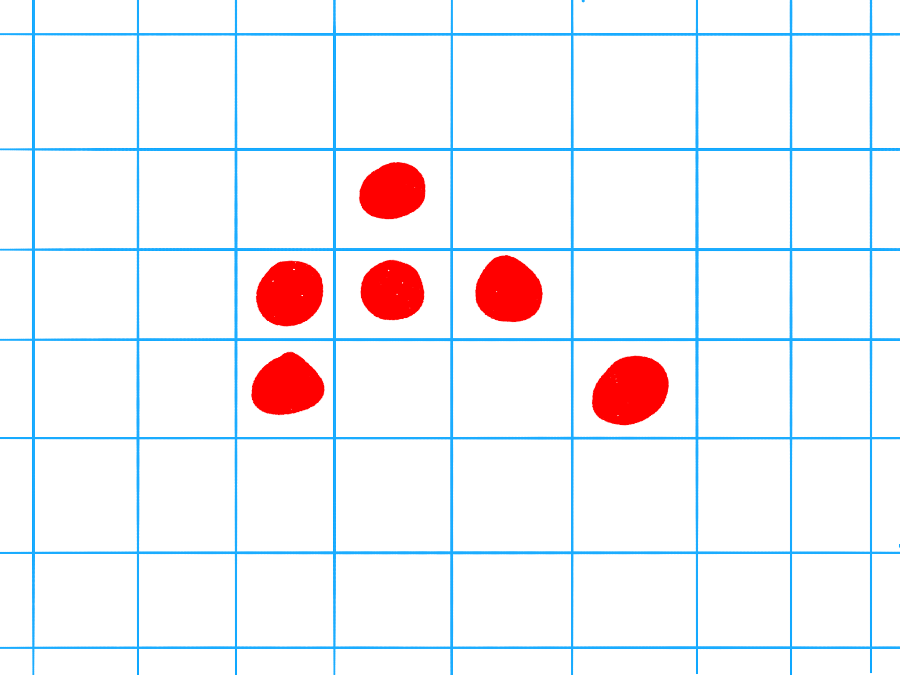
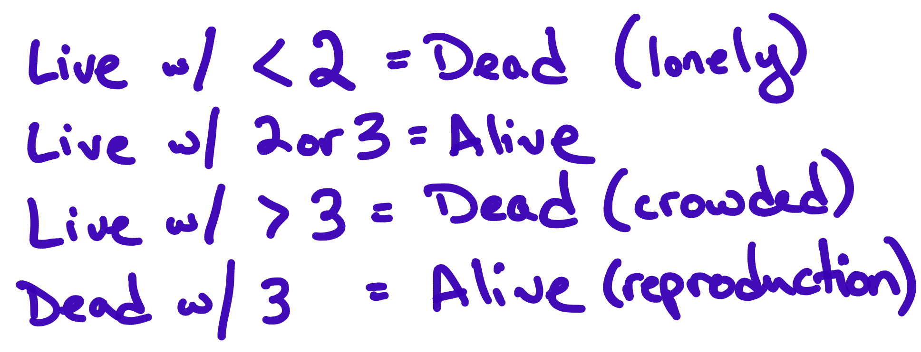
@jeremybytes
Notes:
Conway's Game of Life Rules
Live cell with < 2 live neighbors = Dead (loneliness)
Live cell with 2 or 3 live neighbors = Alive (healthy)
Live cell with more than 3 live neighbors = Dead (over-crowded)
Dead cell with exactly 3 live neighbors = Alive (reproduction)

Slide 23
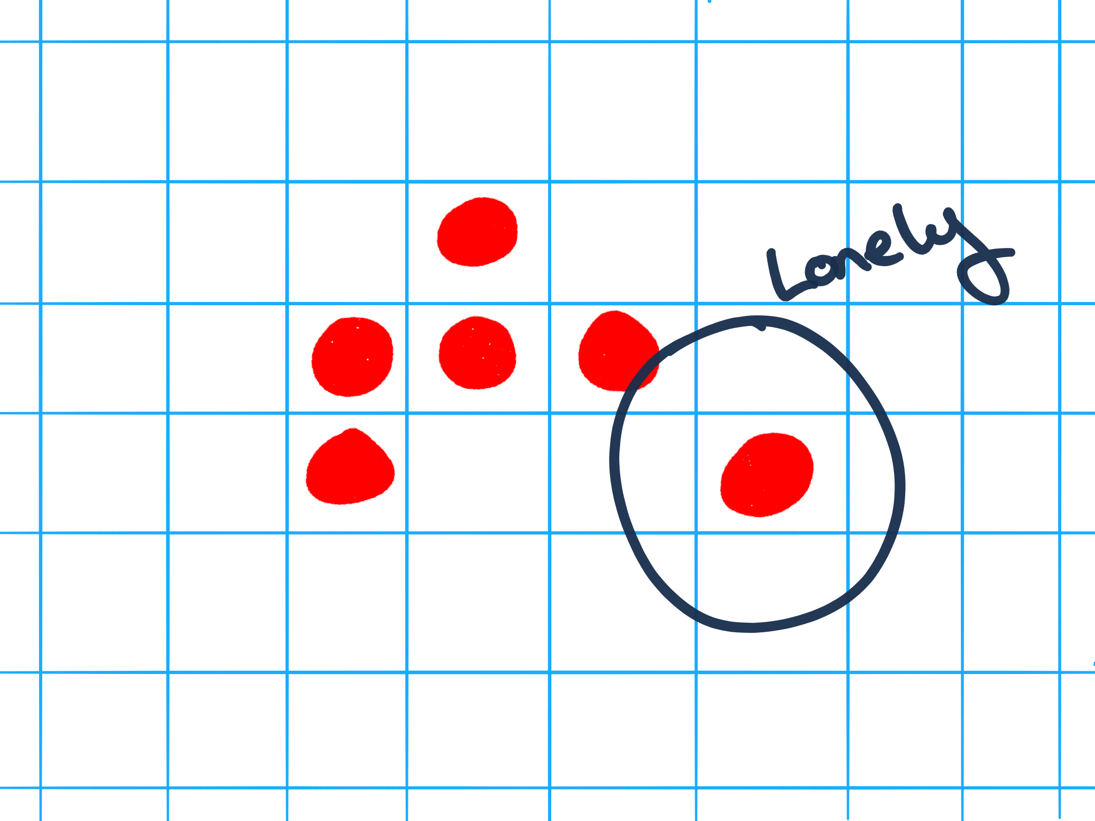
@jeremybytes

Slide 24
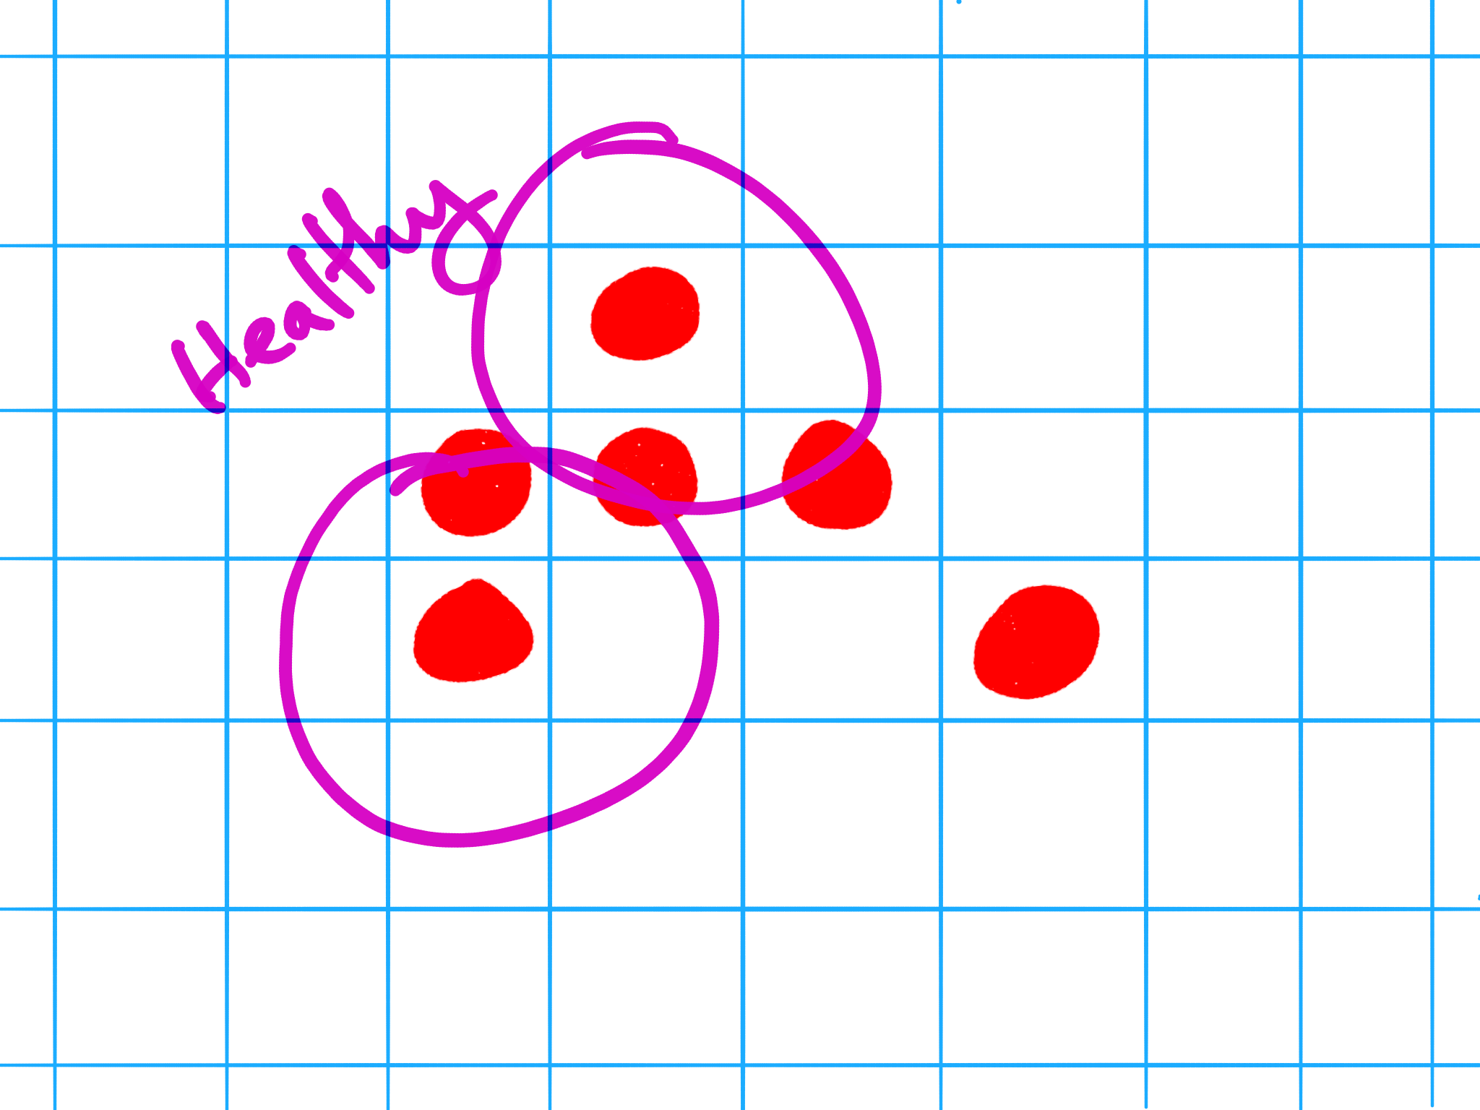
@jeremybytes

Slide 25
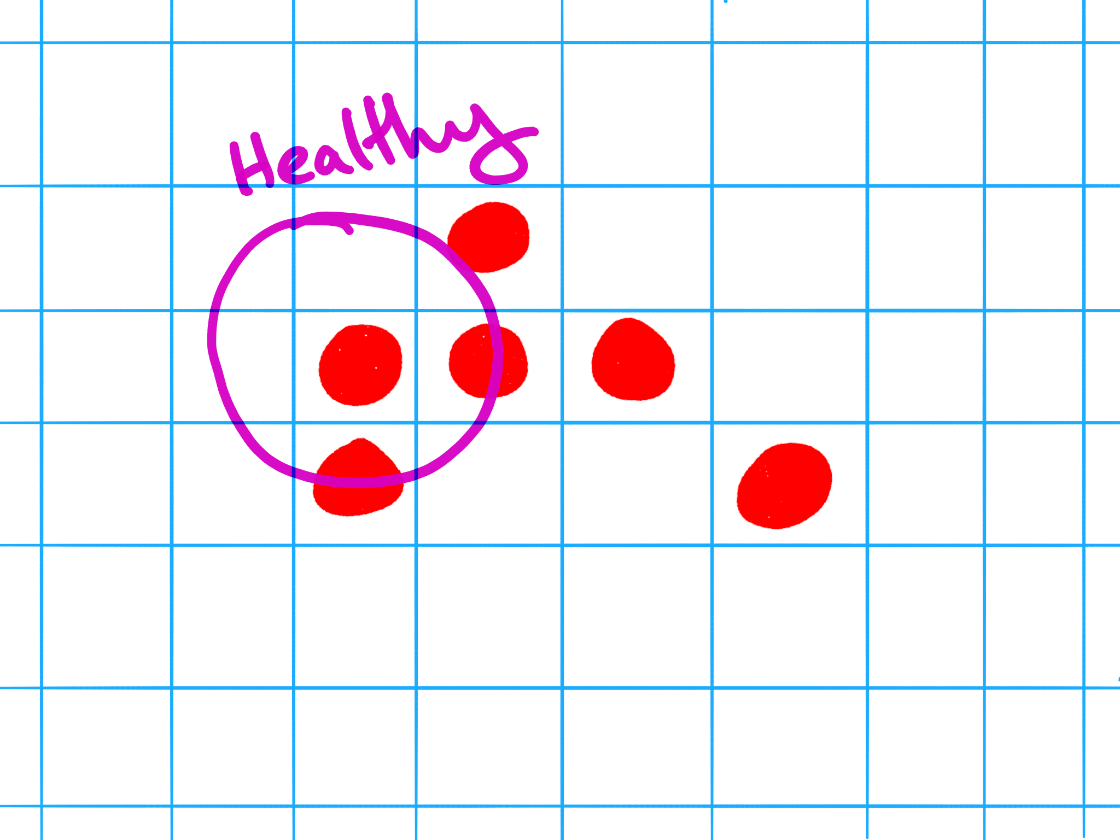
@jeremybytes

Slide 26
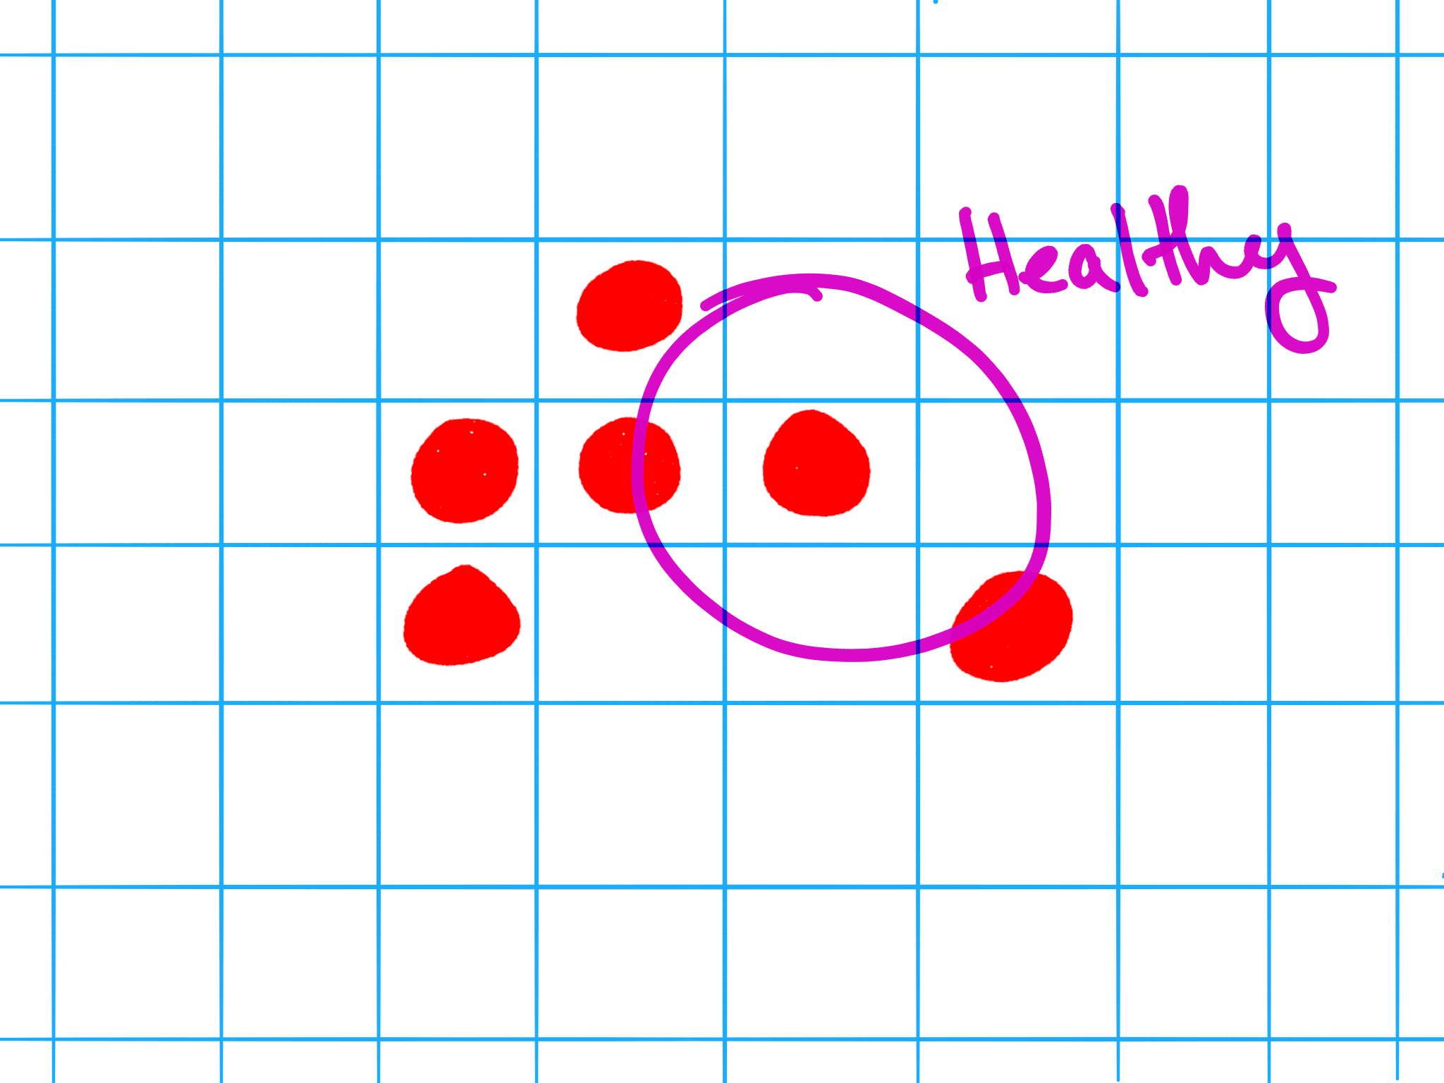
@jeremybytes

Slide 27
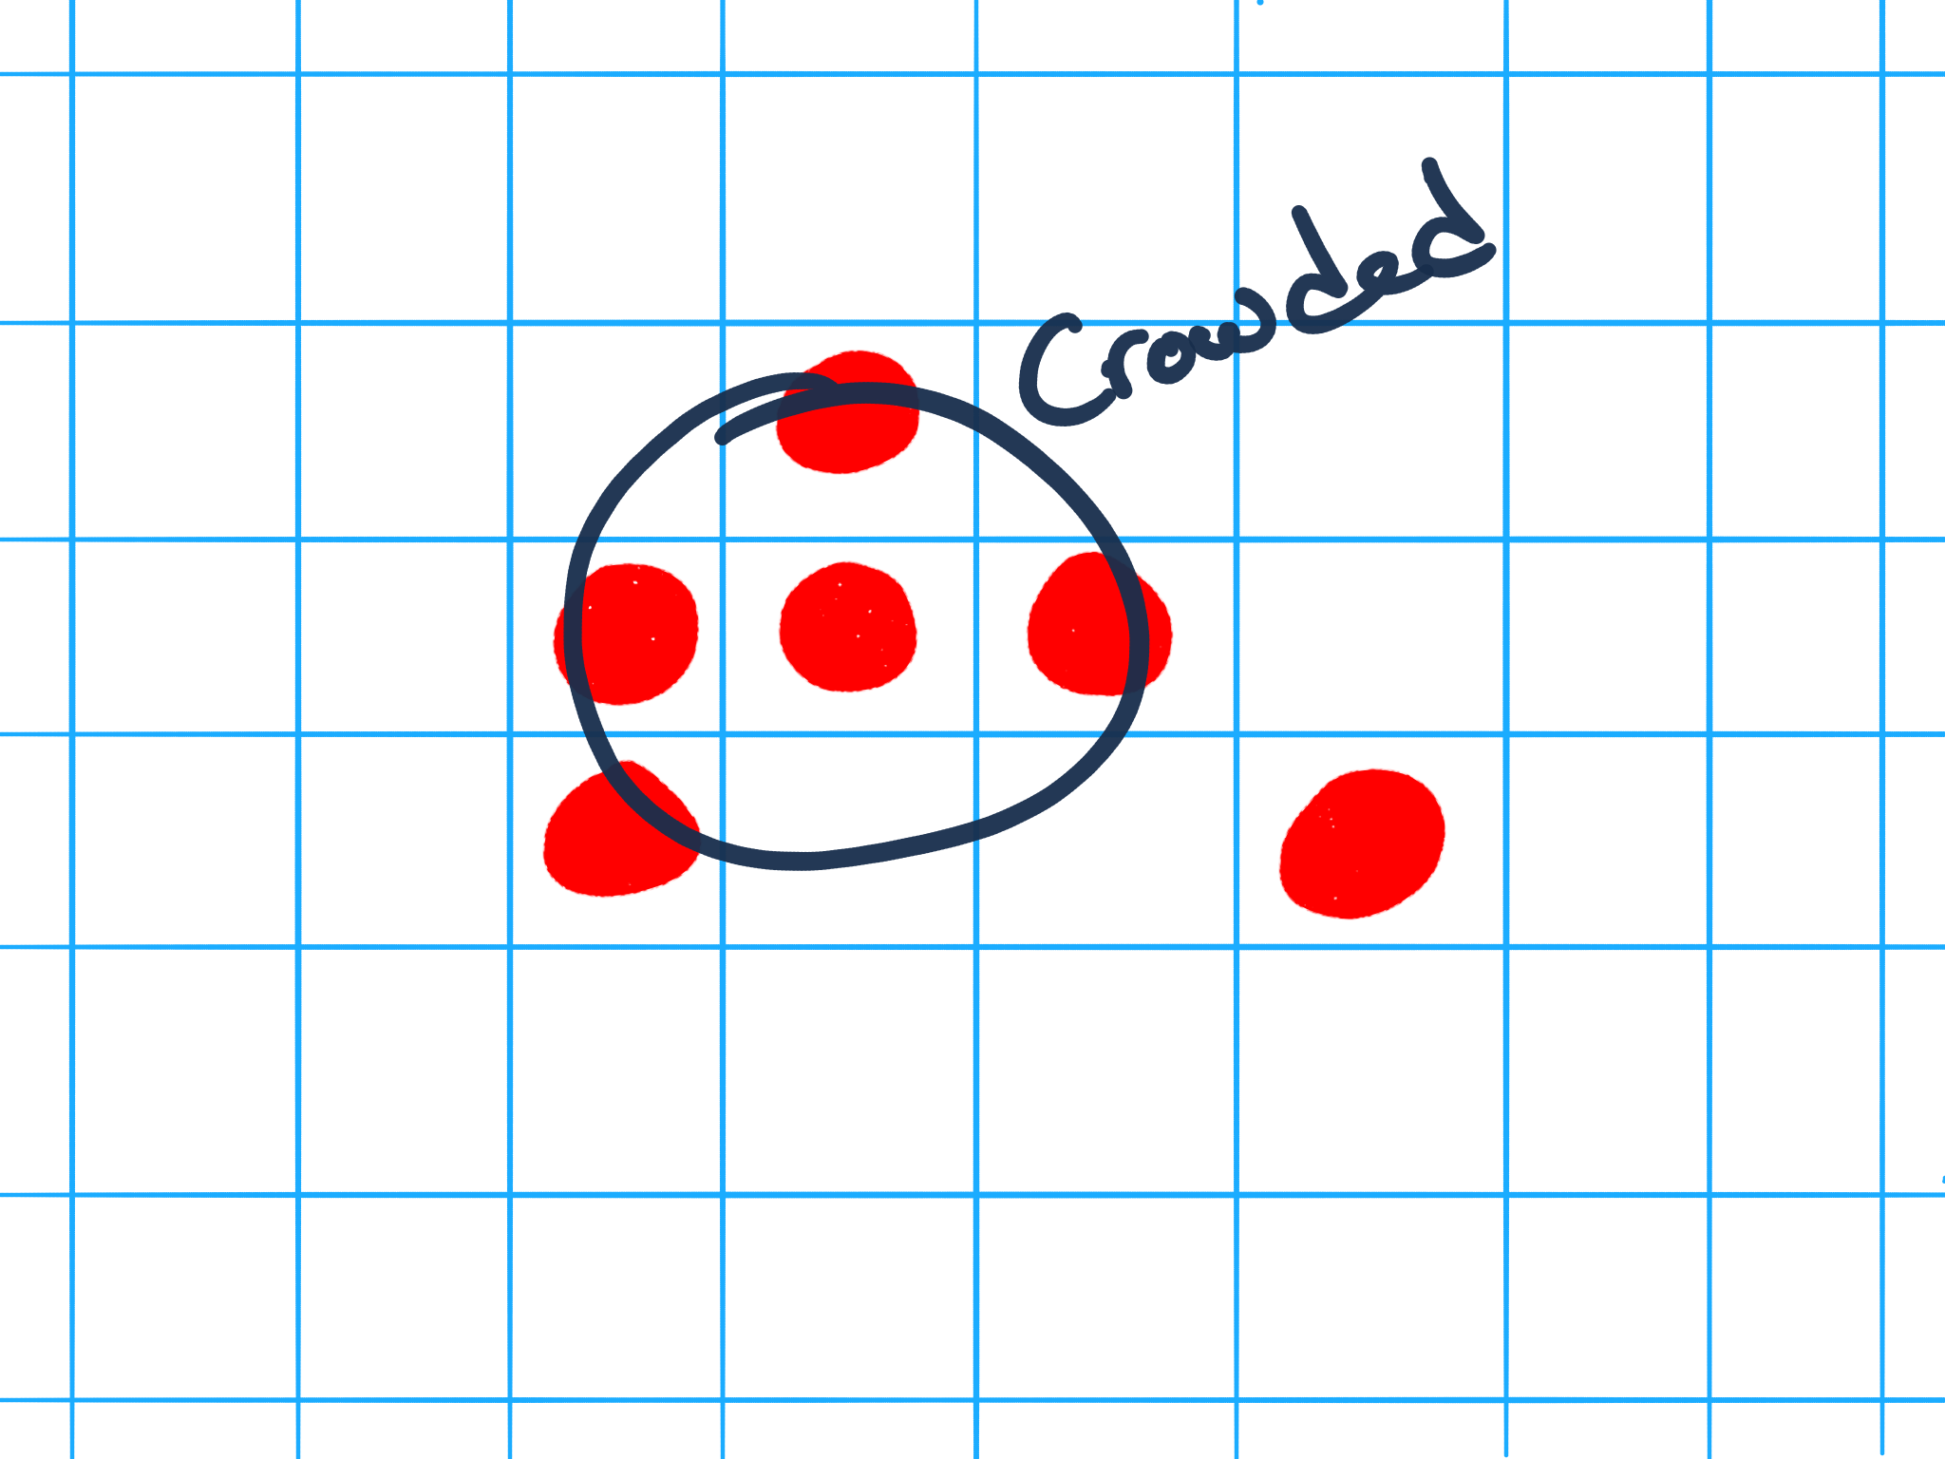
@jeremybytes

Slide 28
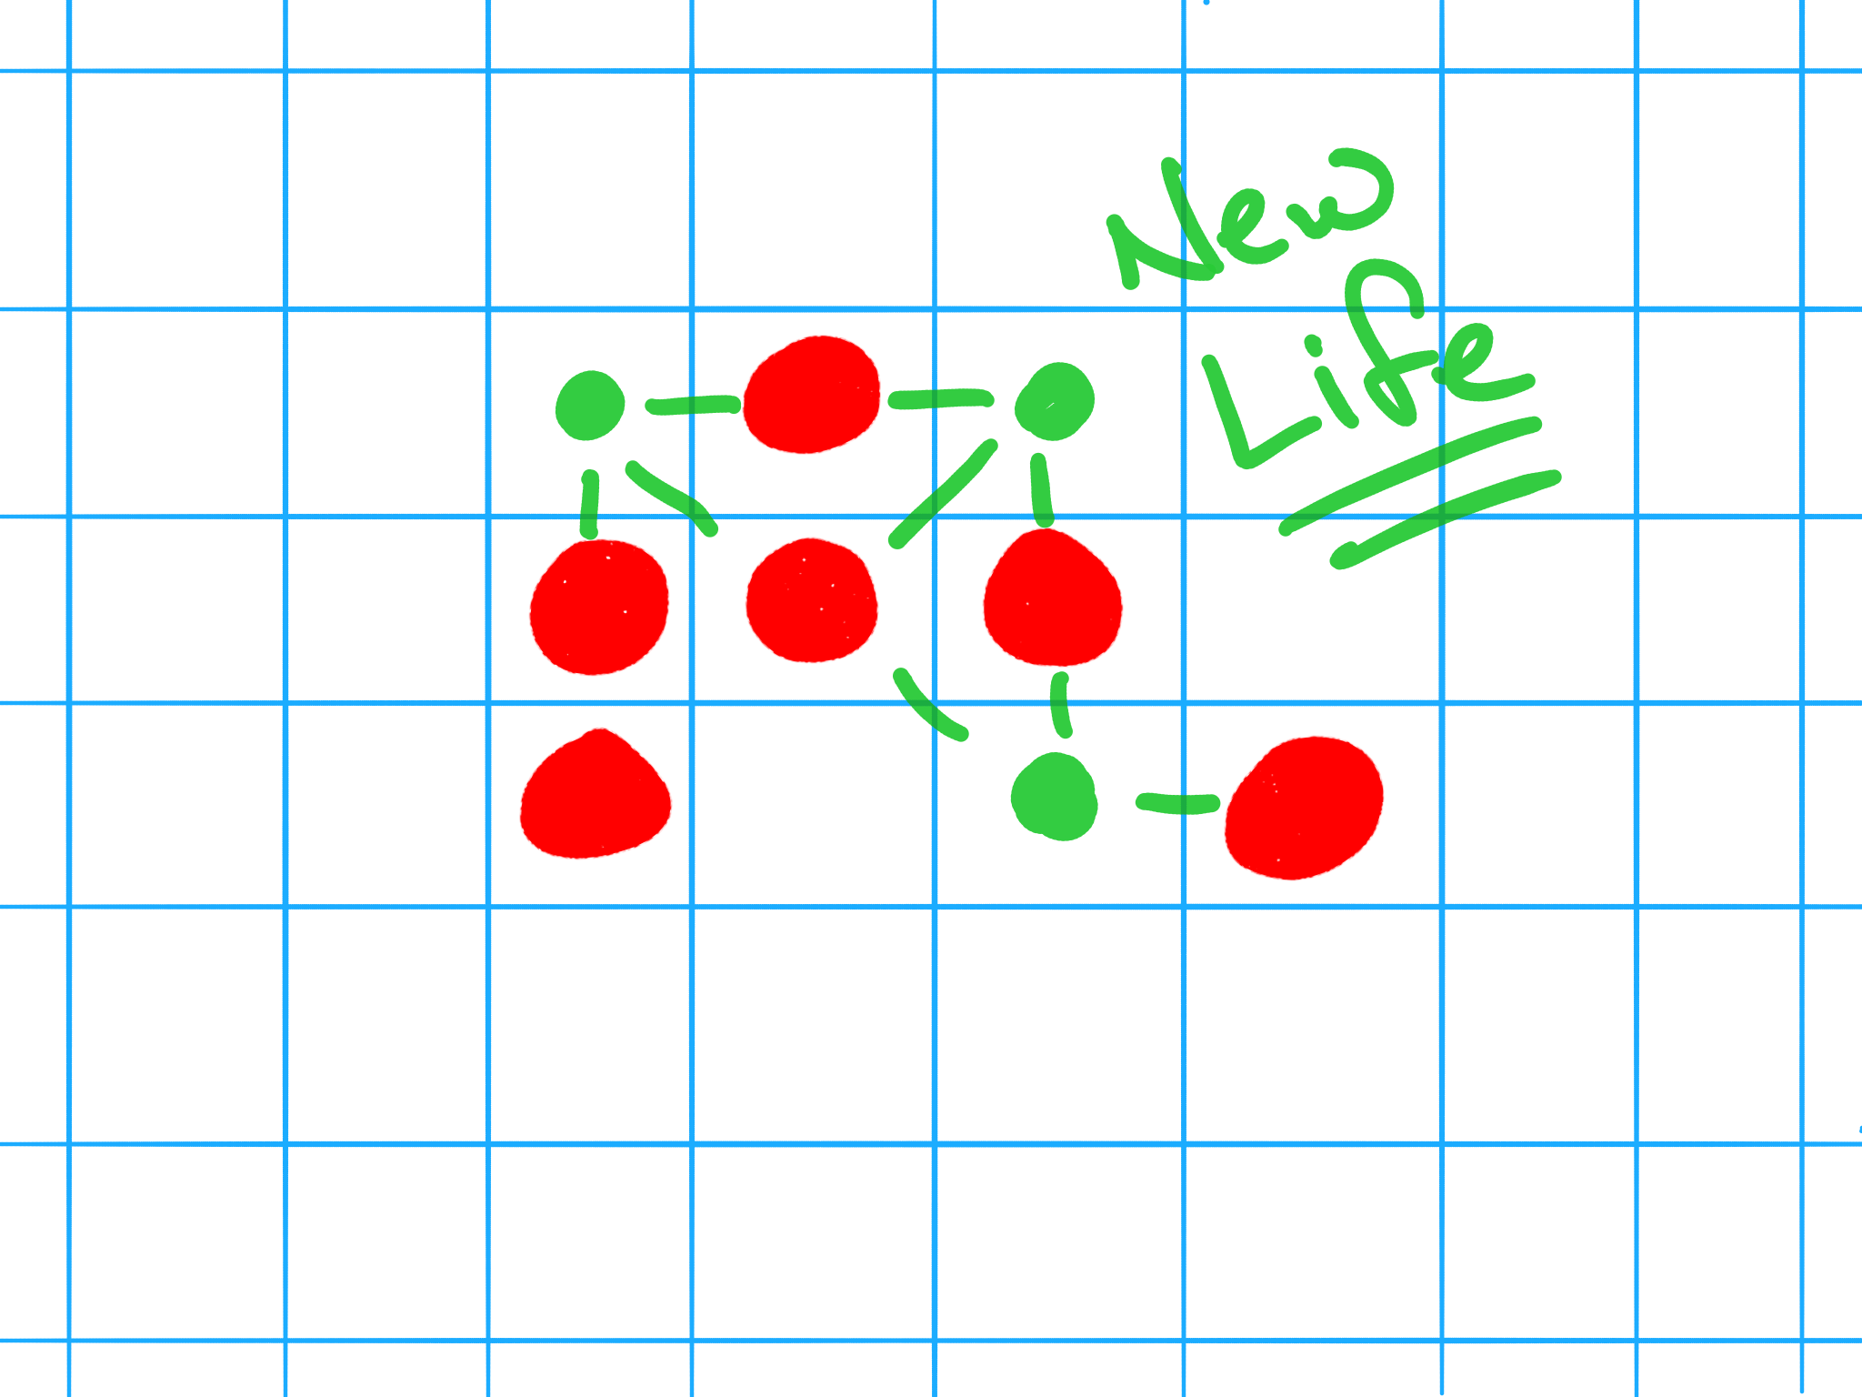
@jeremybytes

Slide 29
@jeremybytes

Slide 30
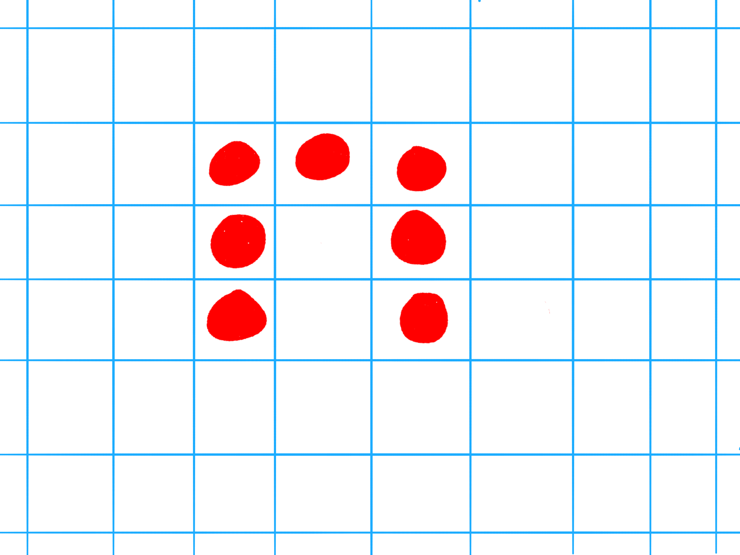
@jeremybytes

Slide 31


@jeremybytes
Notes:
Hard to Run Parallel

Slide 32

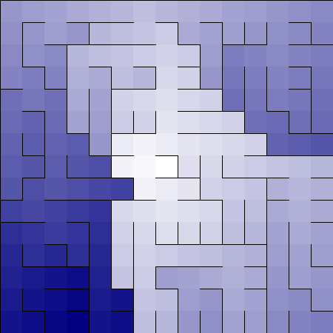
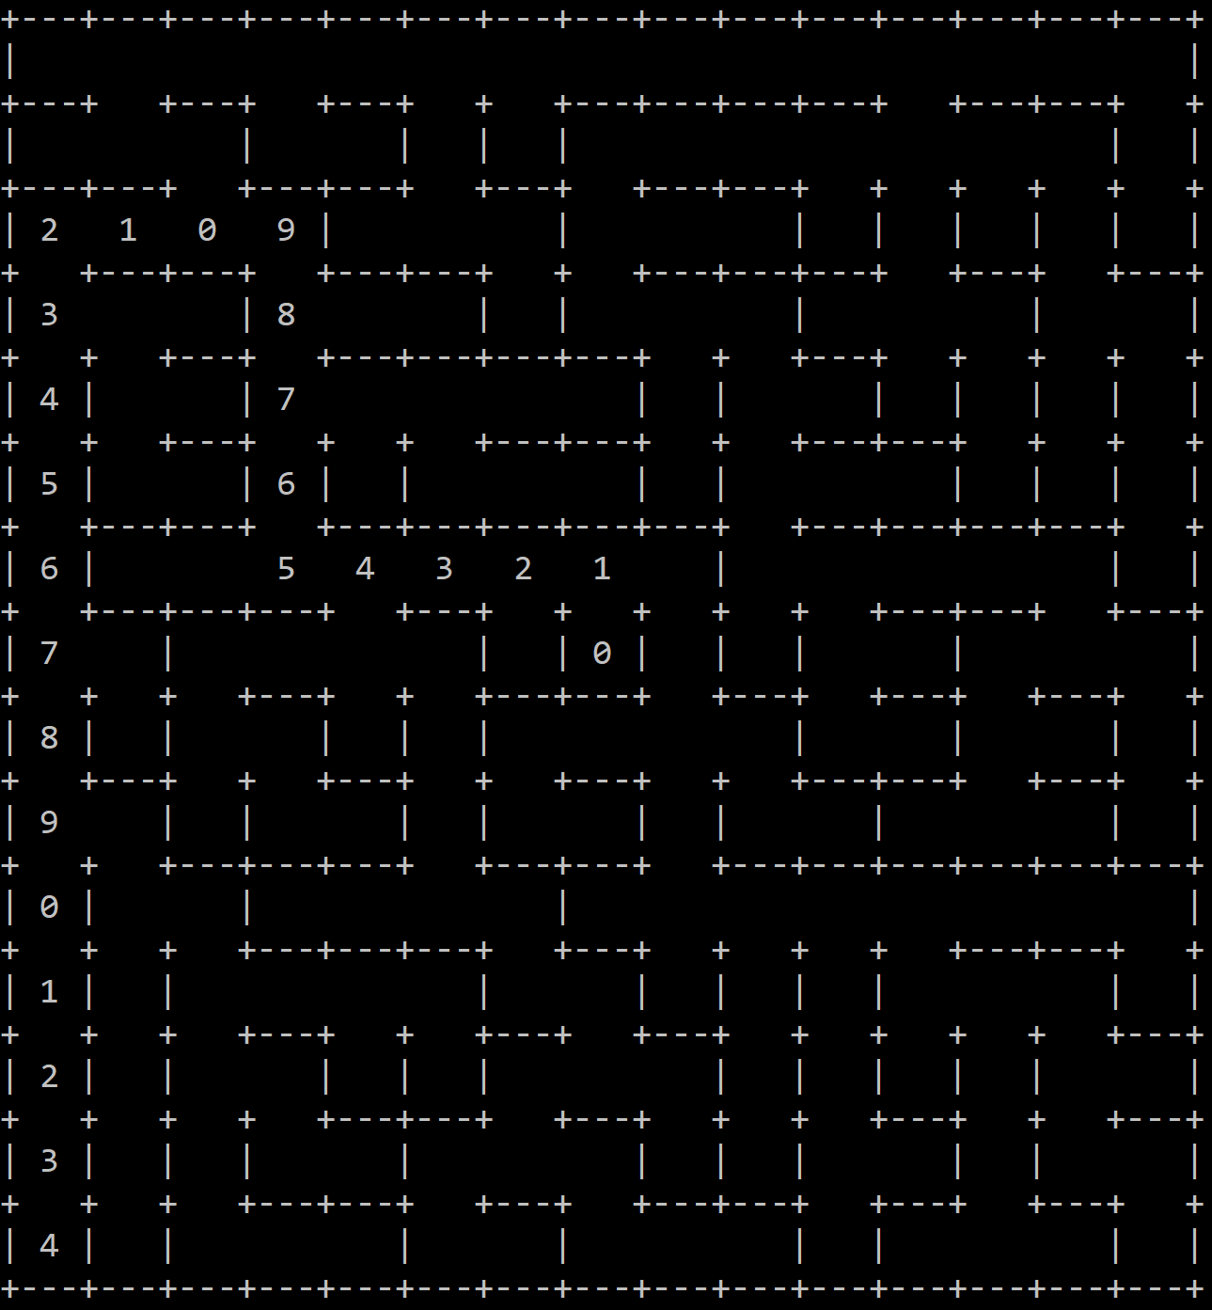
@jeremybytes
Notes:
Example application with code that would be hard to run parallel
Maze generation

Slide 33
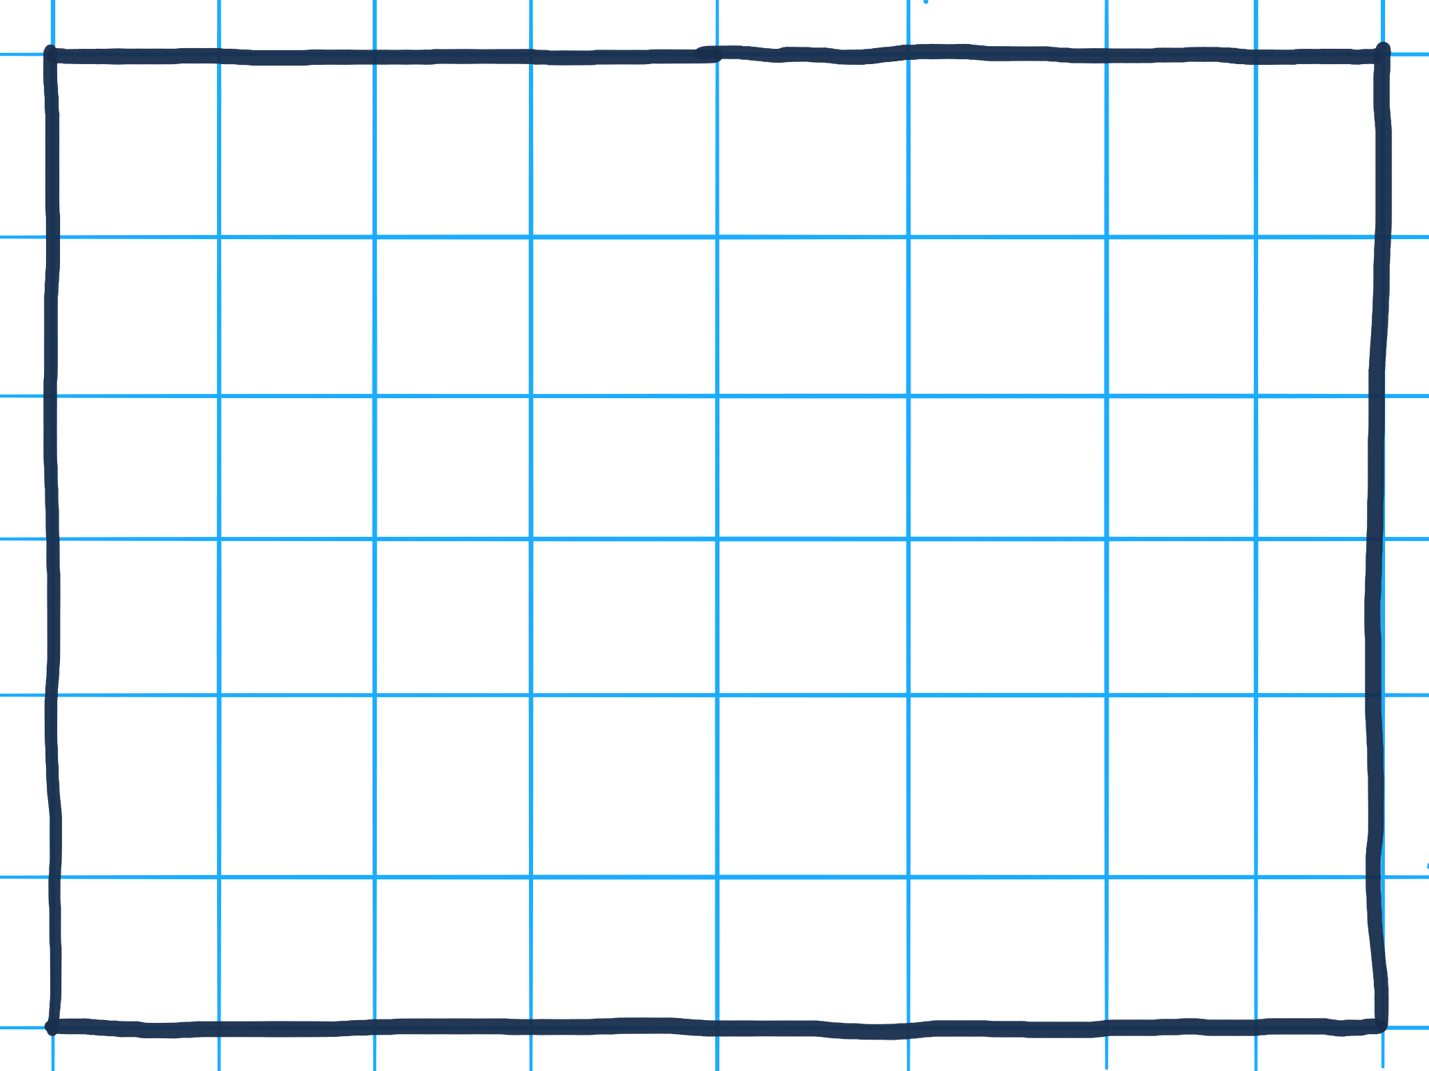

Slide 34
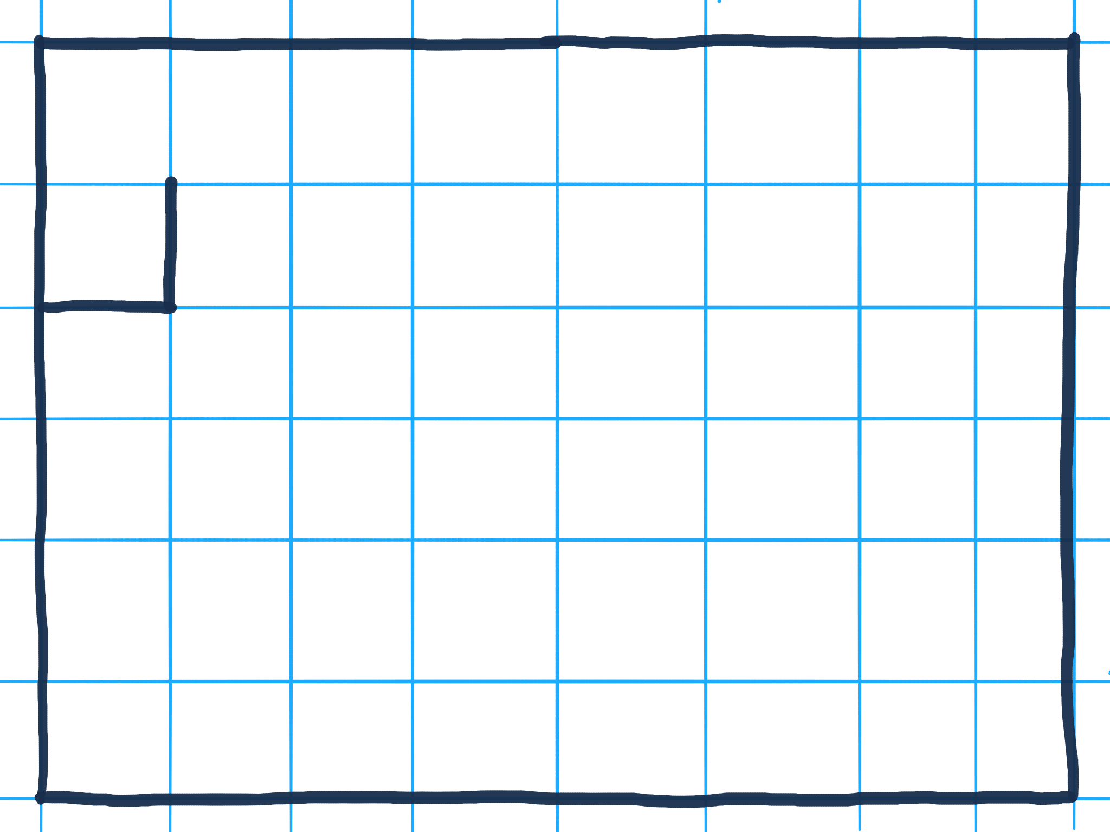

Slide 35
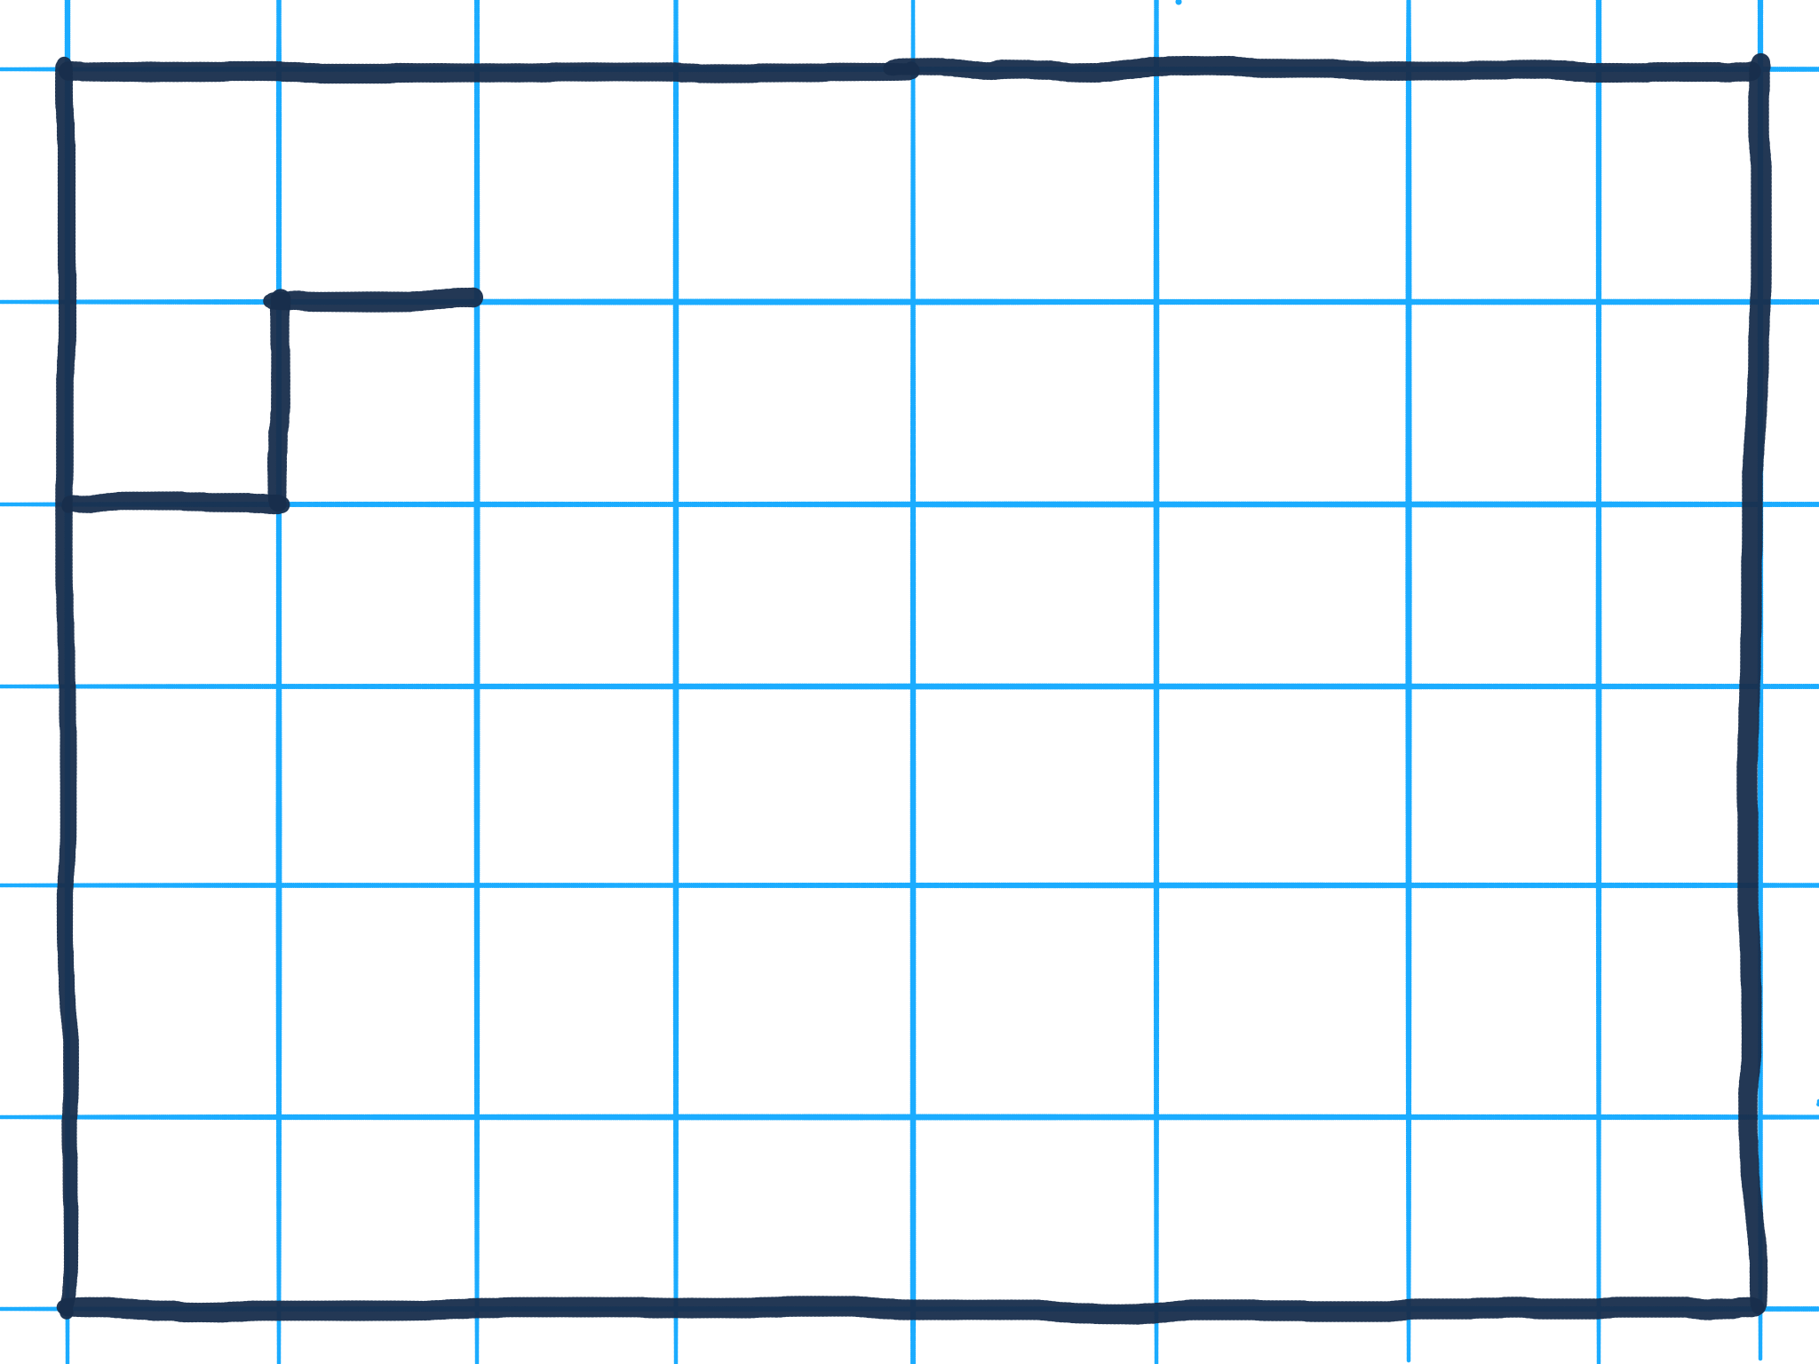

Slide 36
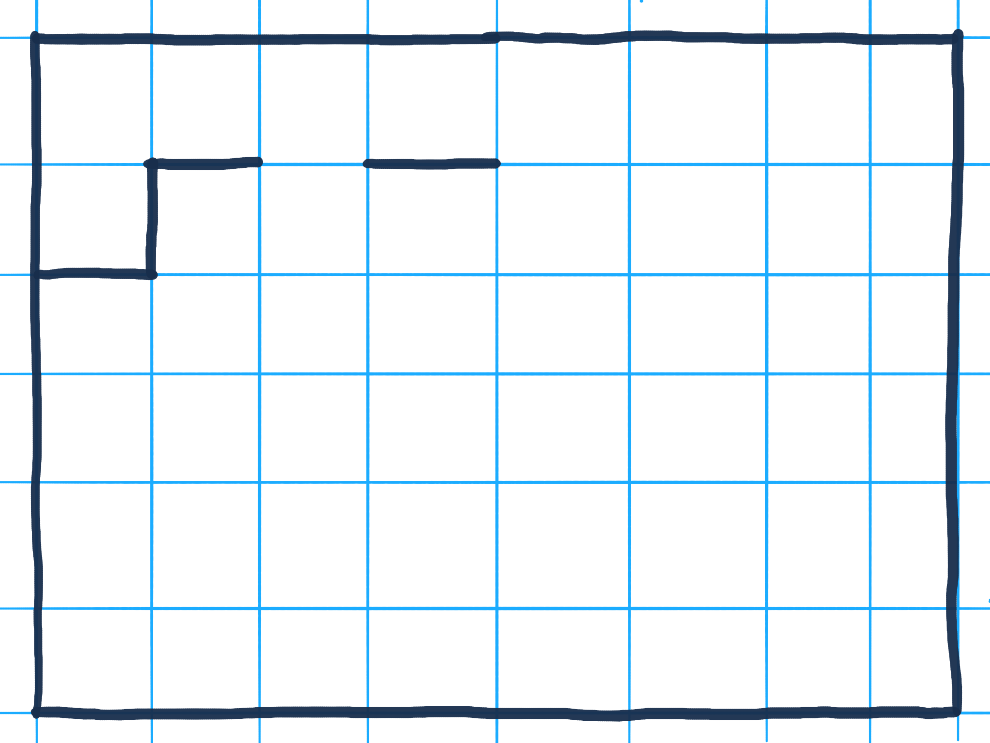

Slide 37
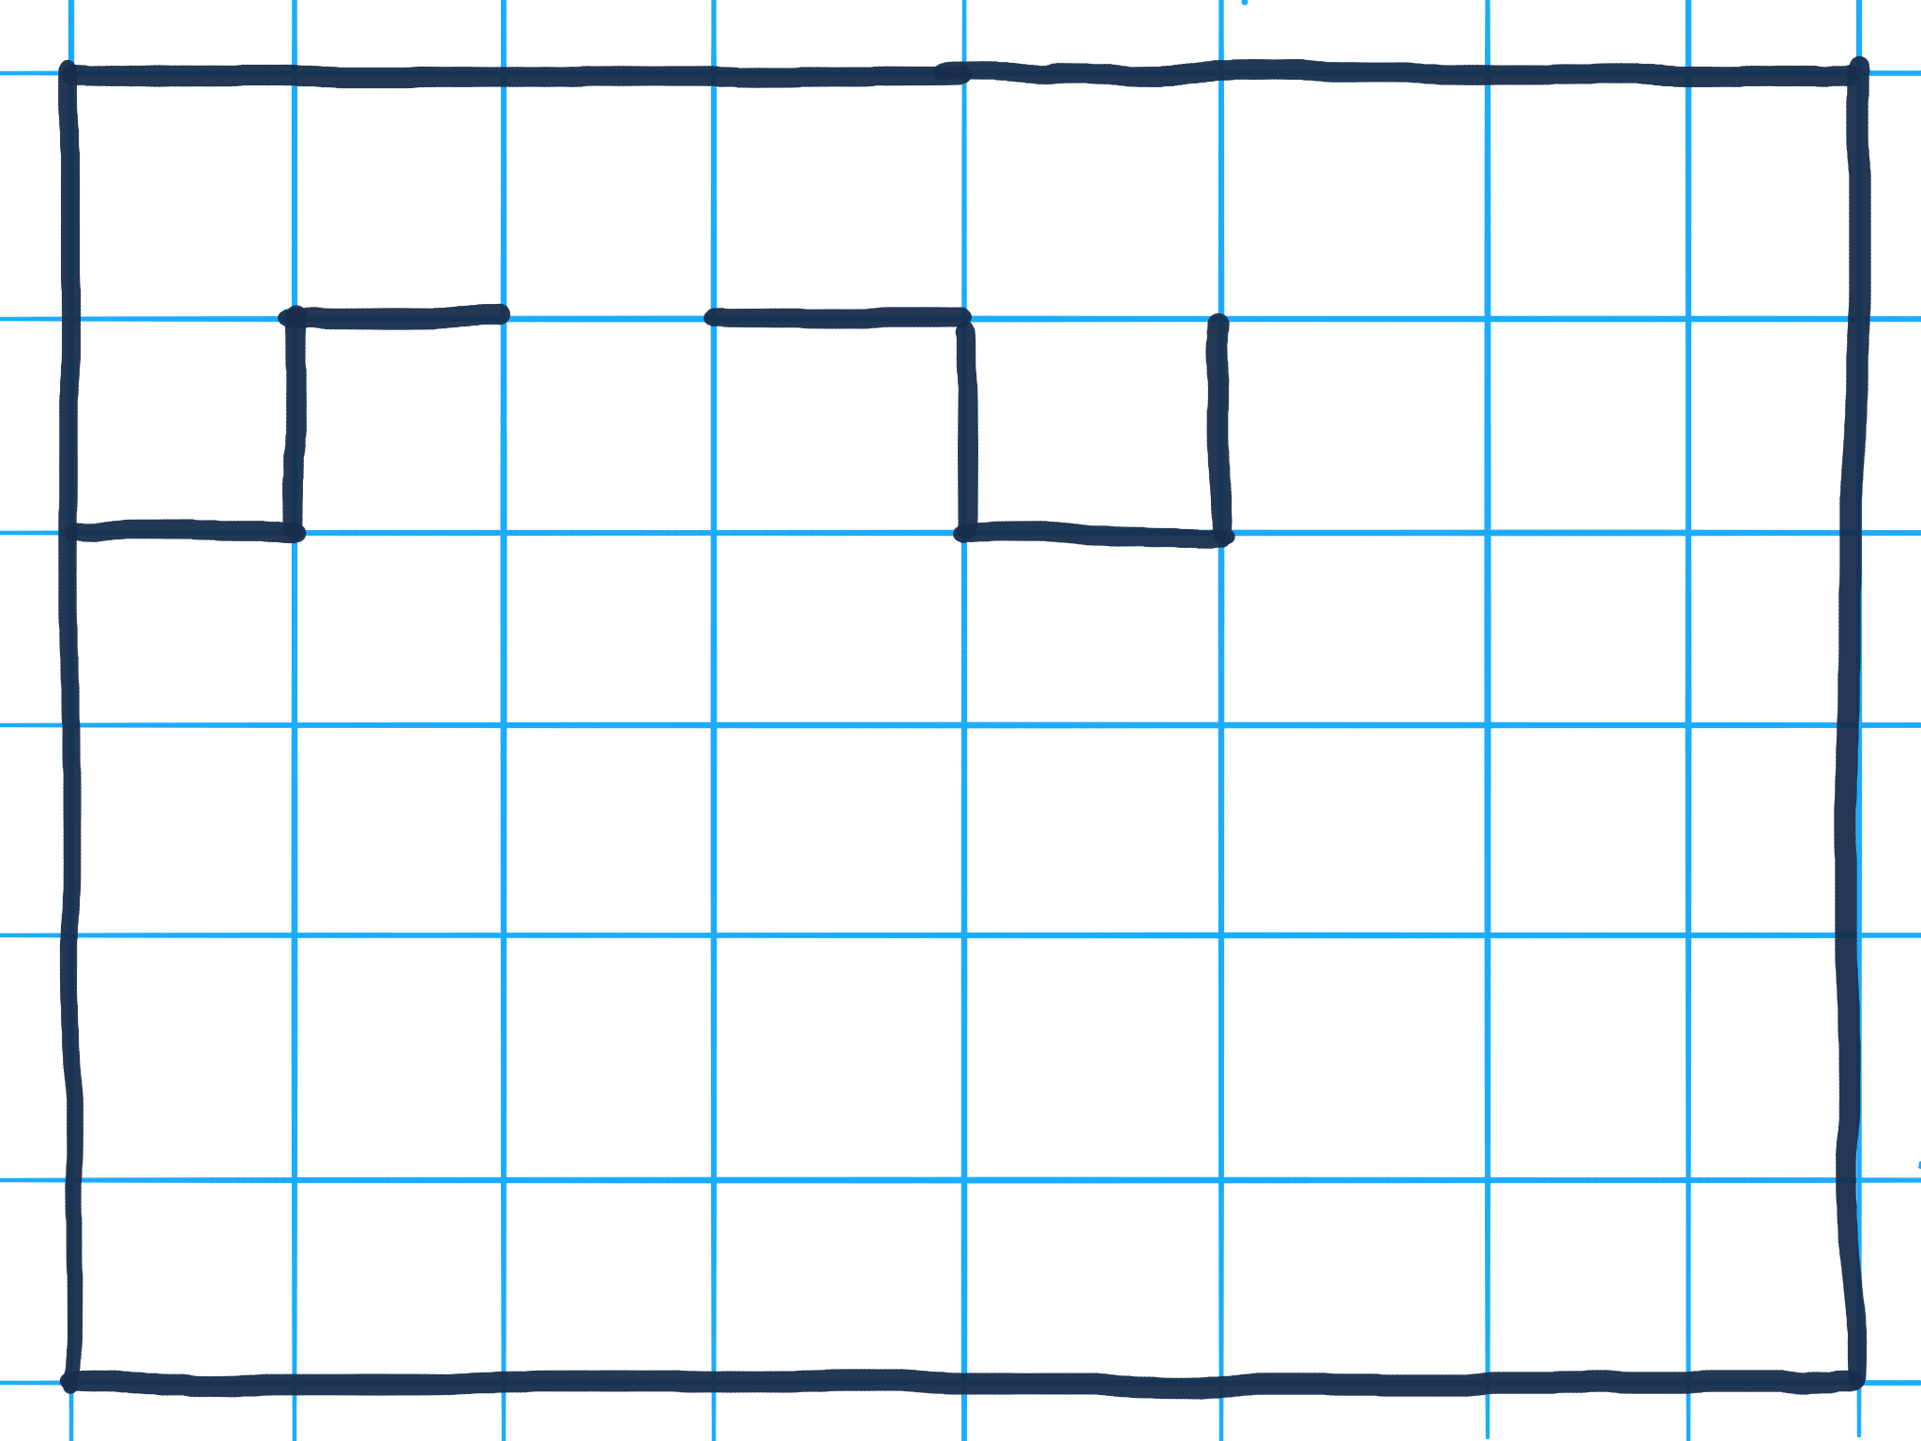

Slide 38
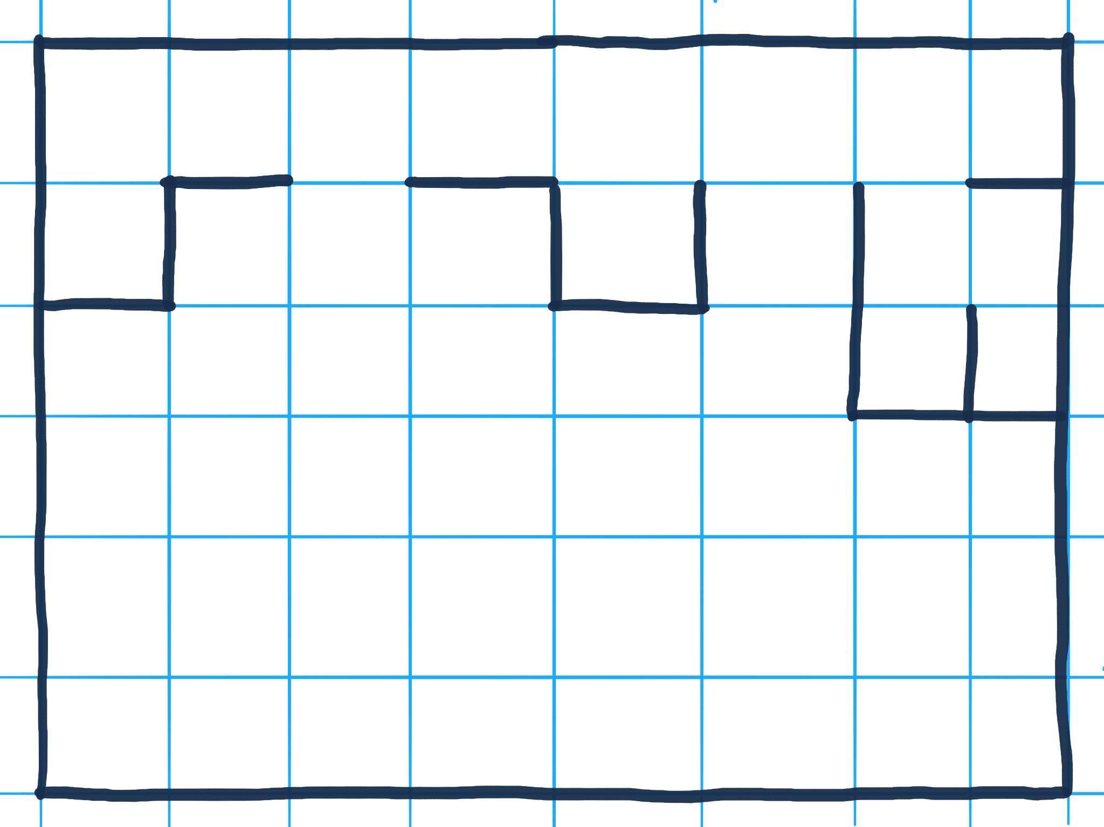

Slide 39
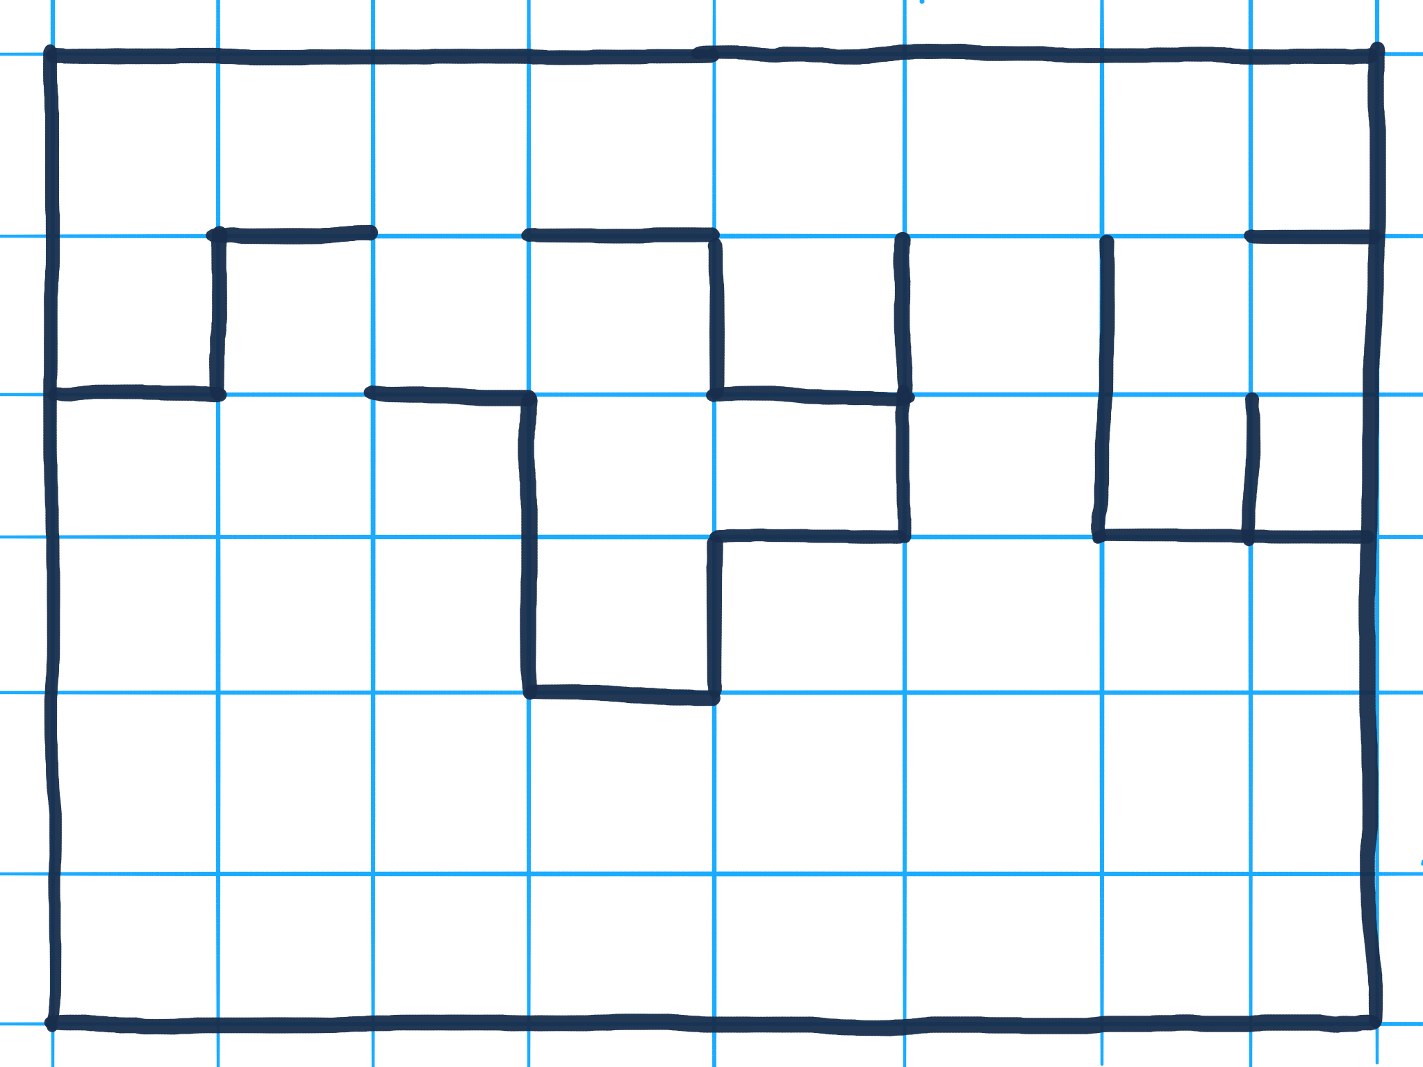

Slide 40
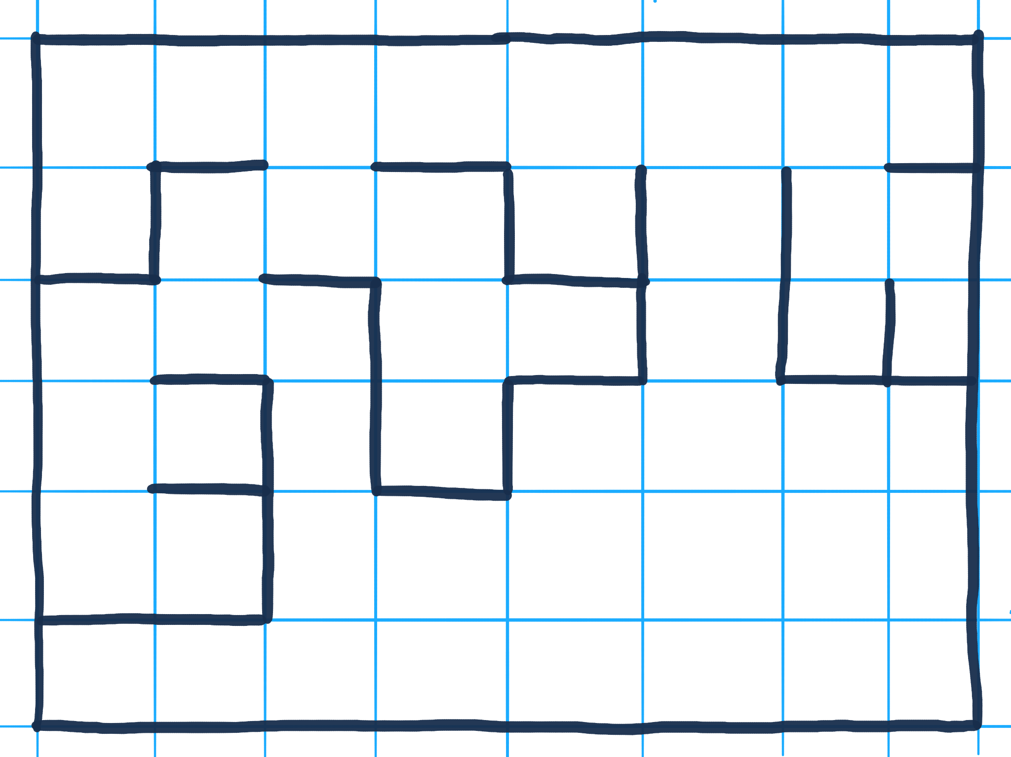

Slide 41
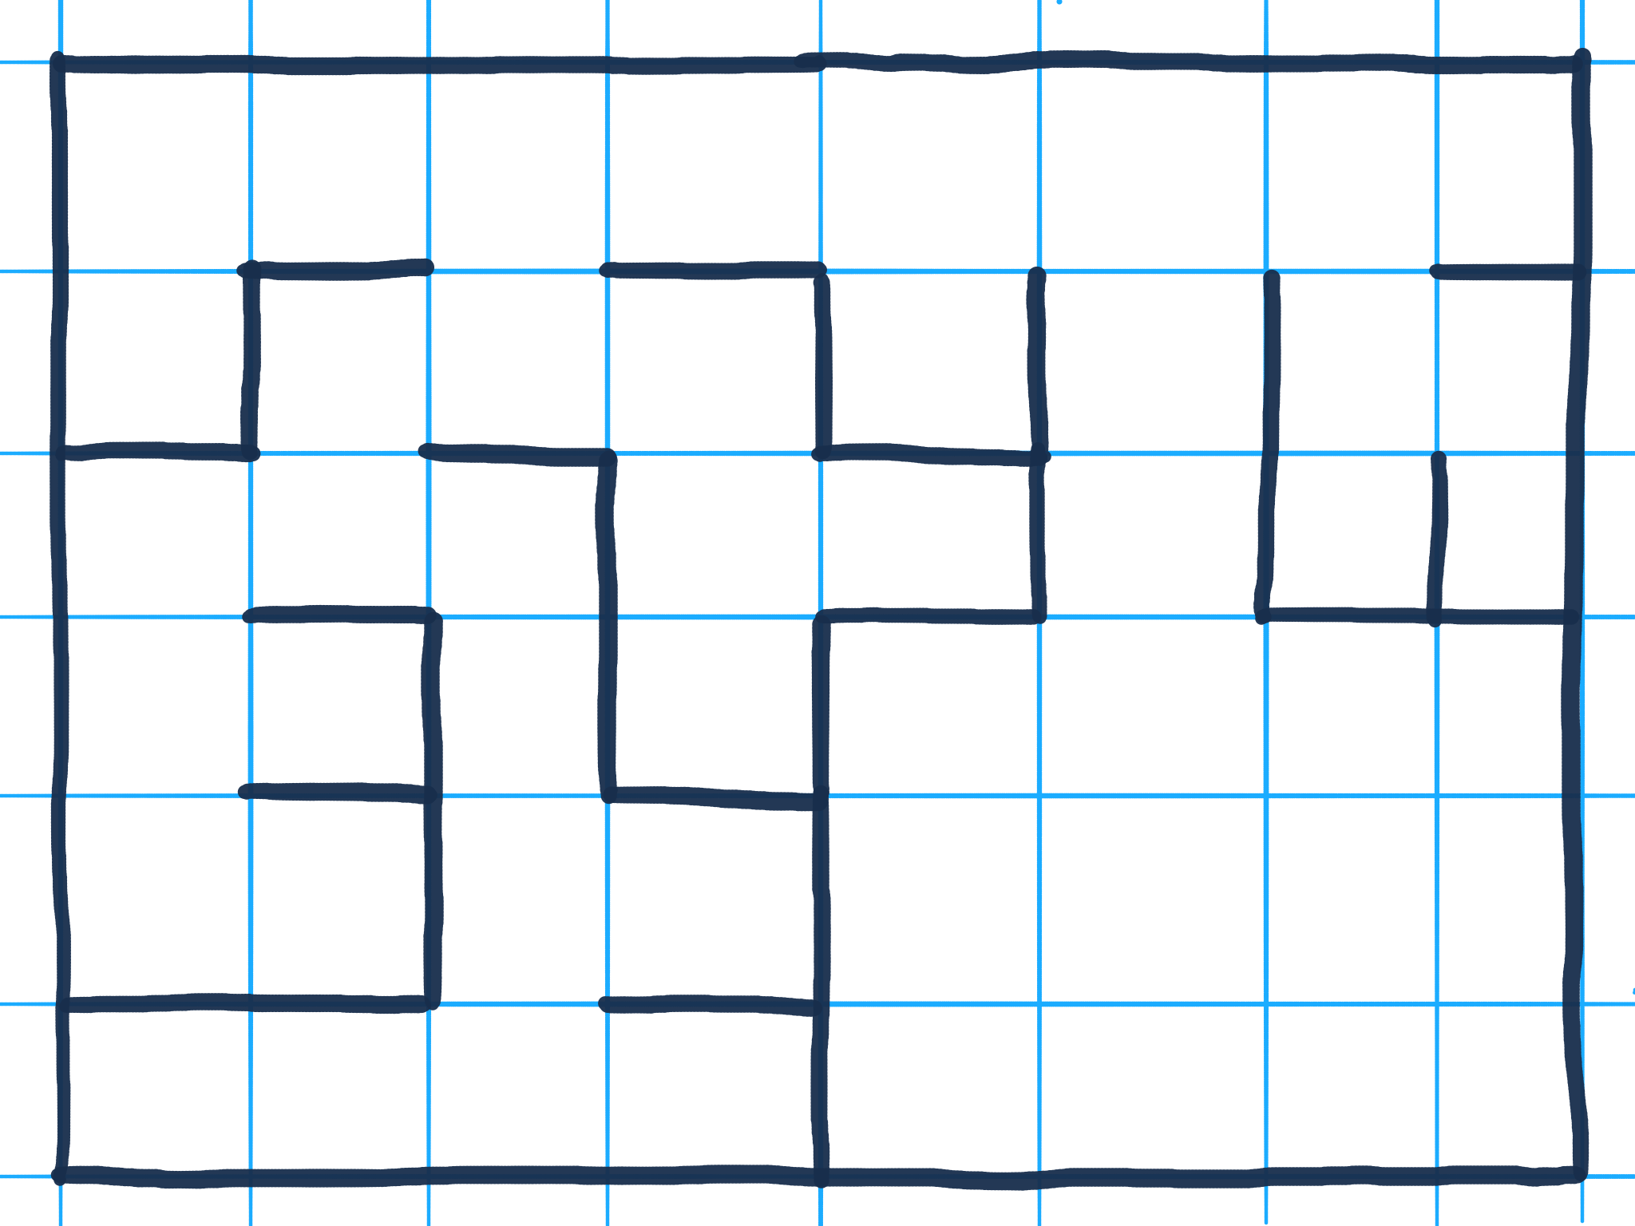

Slide 42
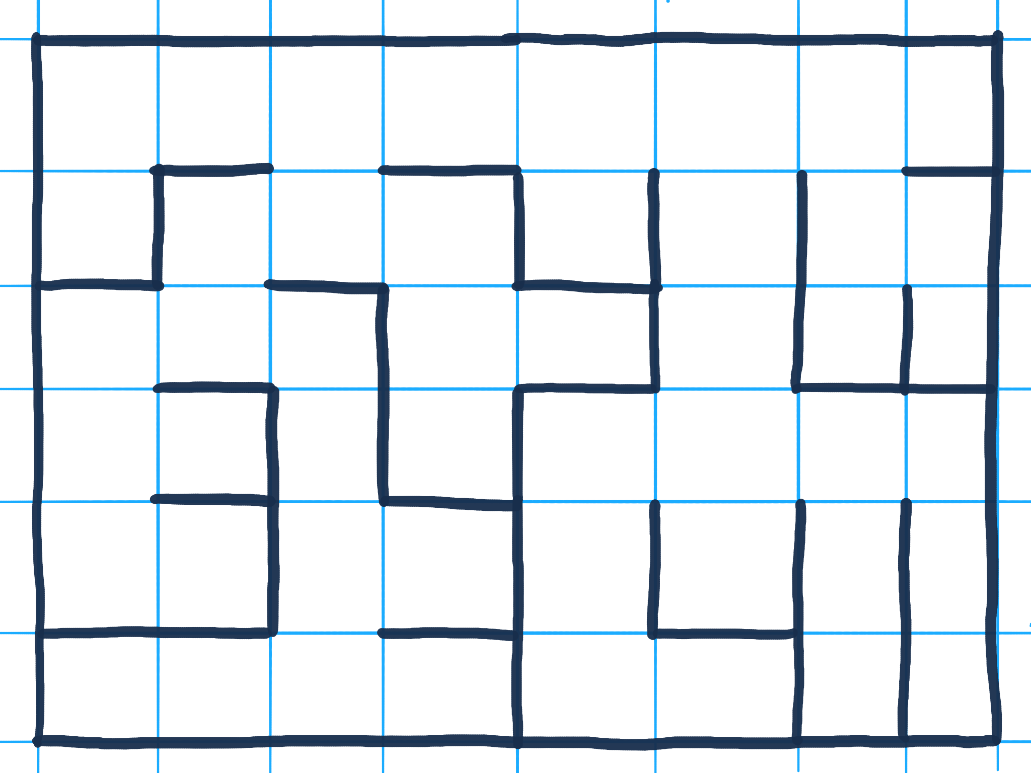

Slide 43

@jeremybytes
Notes:
Parallel Tasks

Slide 44

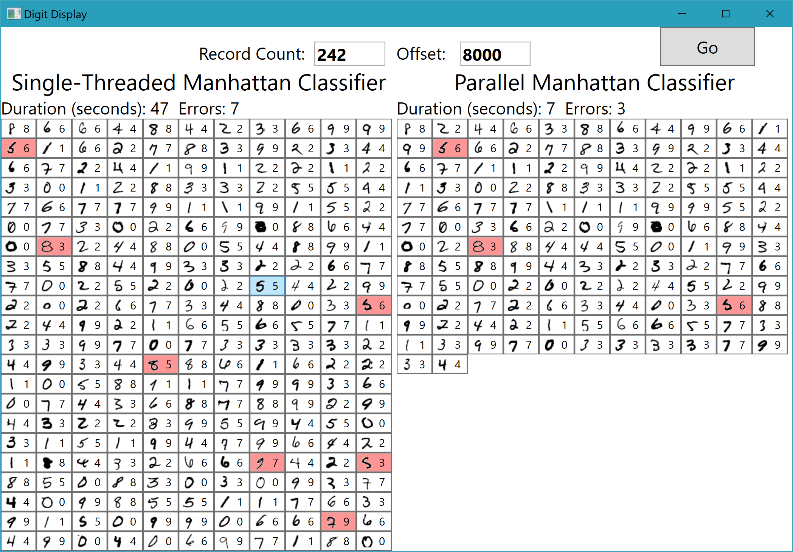
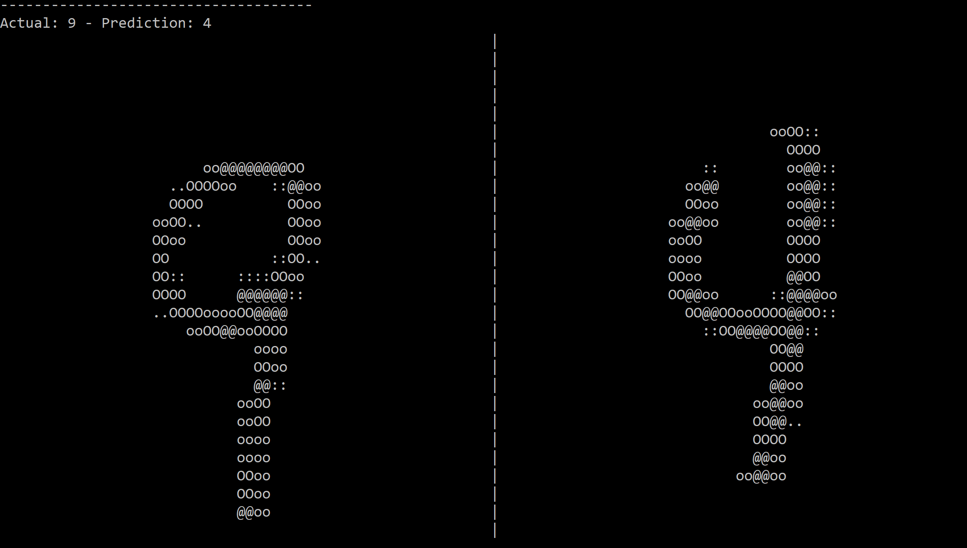
@jeremybytes
Notes:
Example application using Parallel Tasks
Digit recognition

Slide 45
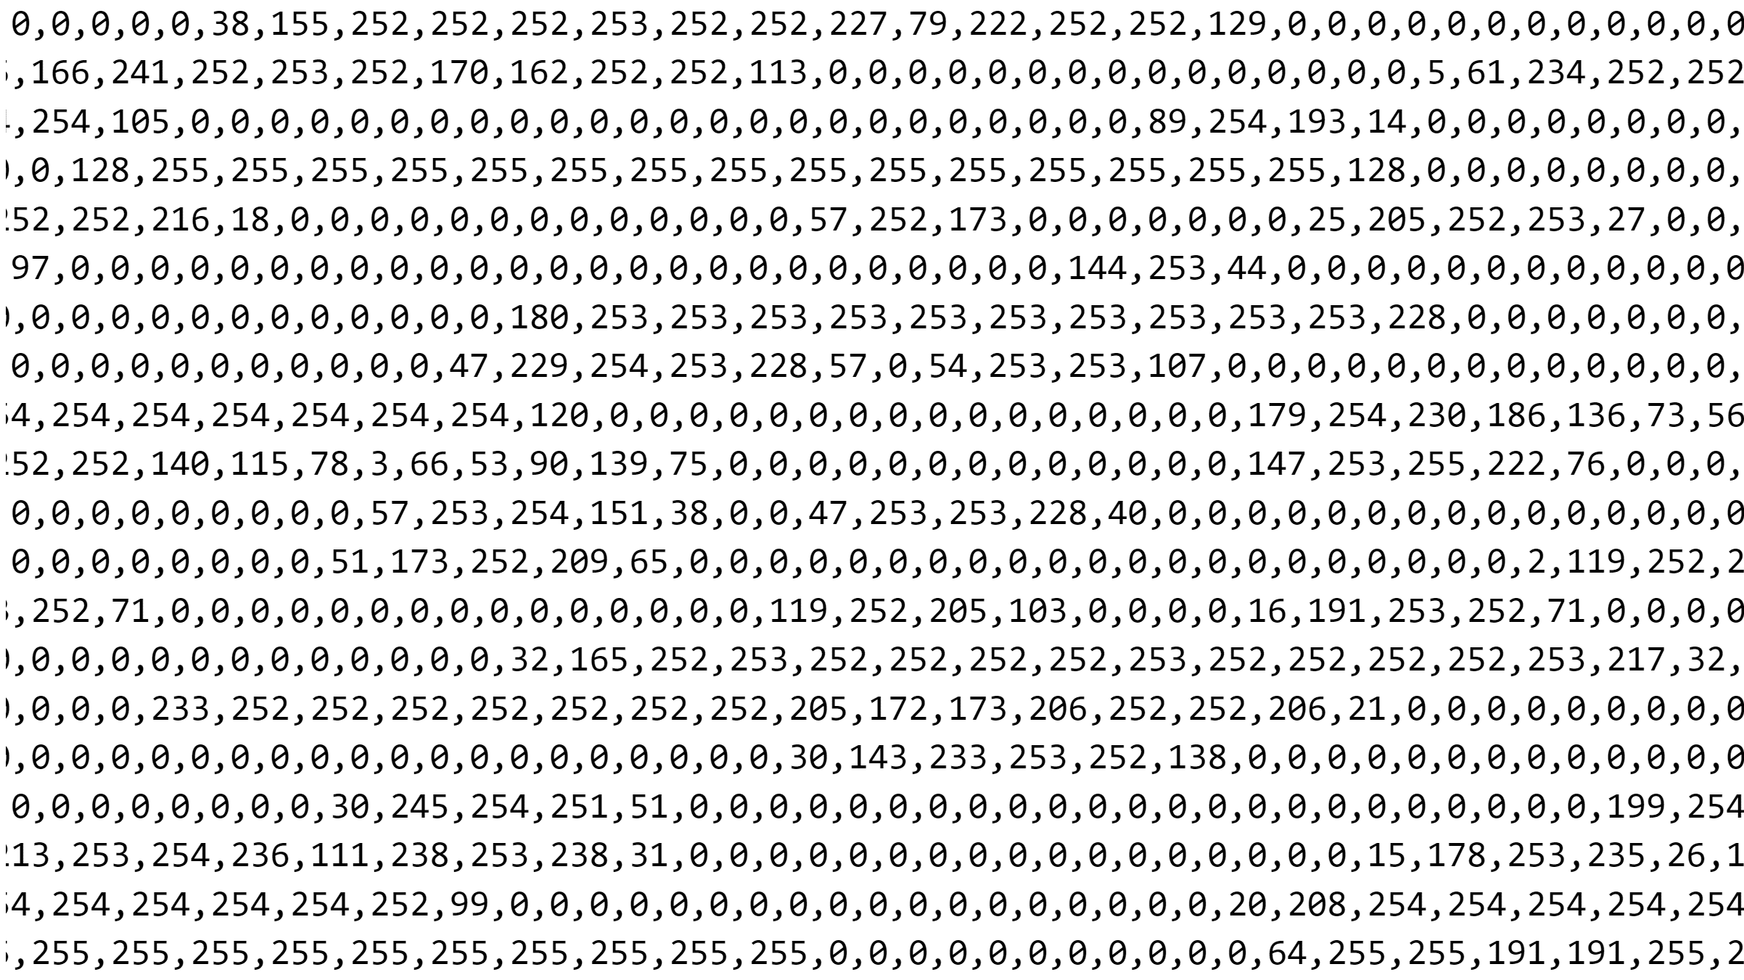
@jeremybytes

Slide 46

@jeremybytes
Notes:
Example application using Parallel Tasks
Digit recognition

Slide 47
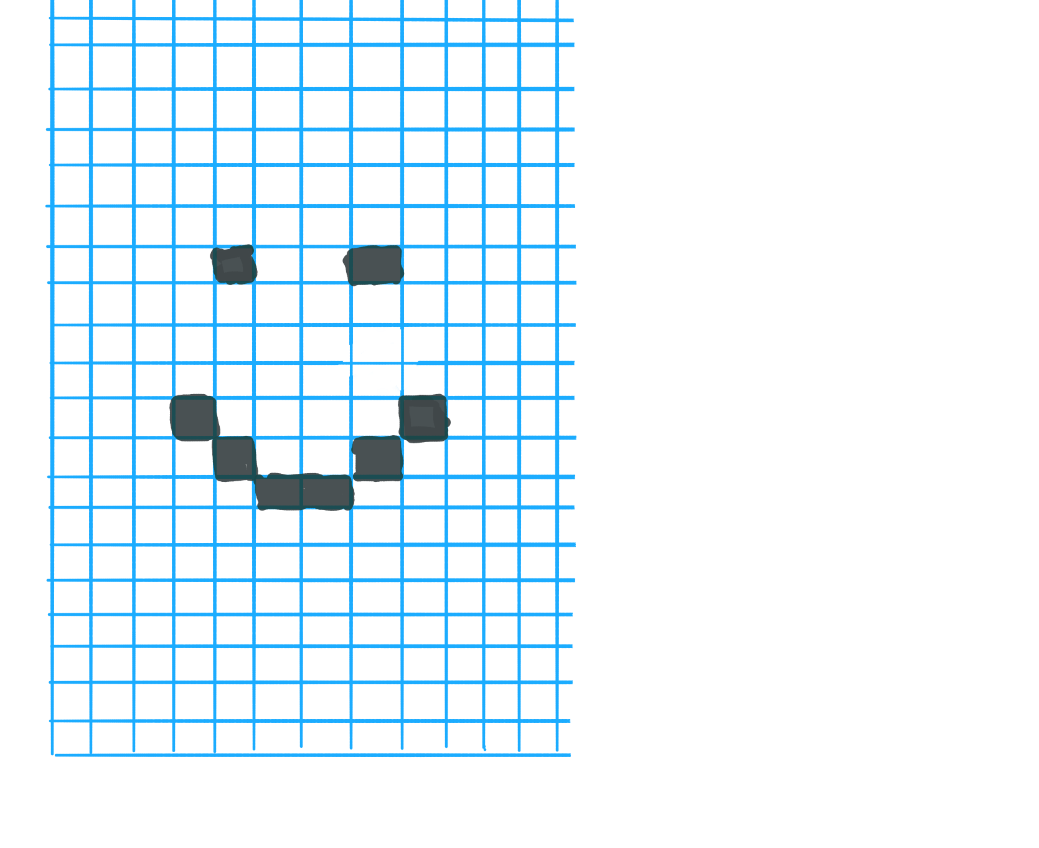

@jeremybytes
Notes:
Example application using Parallel Tasks
Digit recognition

Slide 48
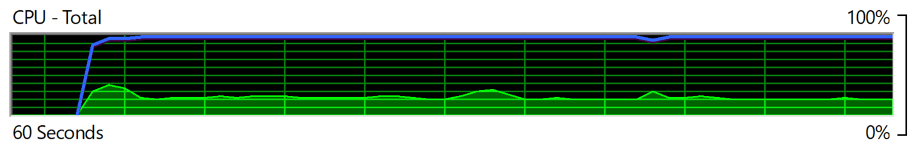
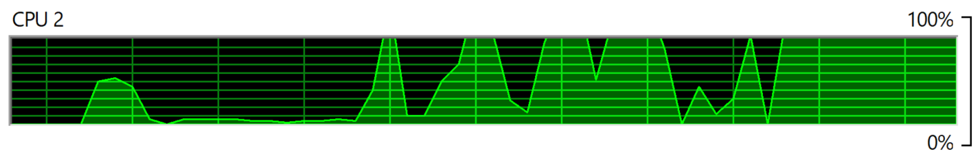
@jeremybytes
Notes:
Single-threaded code run
Overall CPU runs at 20% utilization
CPU #2 (1 core) run at 100% utilization

Slide 49
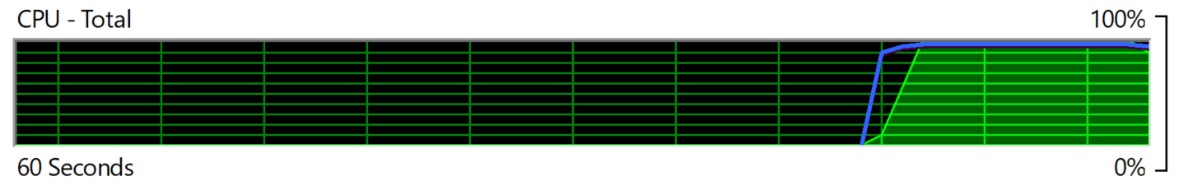
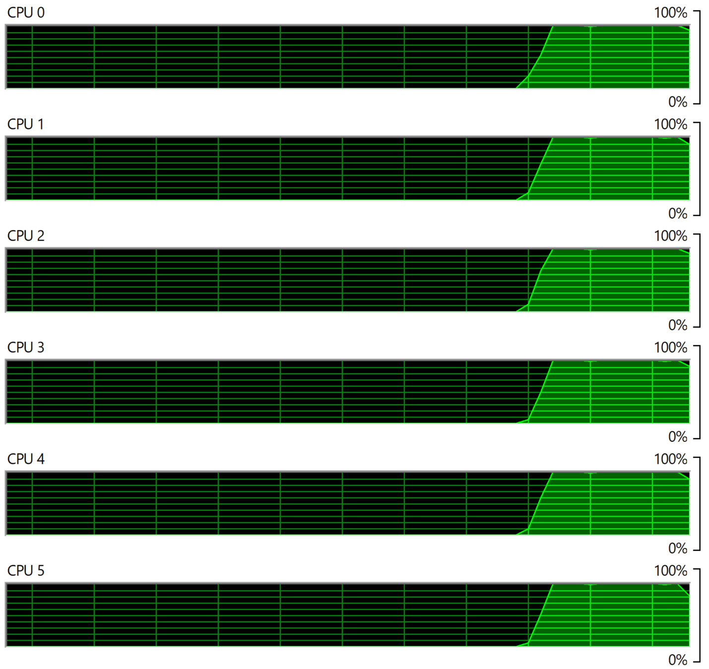
@jeremybytes
Notes:
Parallel code run
Overal CPU at 100% utilization
6 cores running at 100% utilization (other cores not shown)

Slide 50
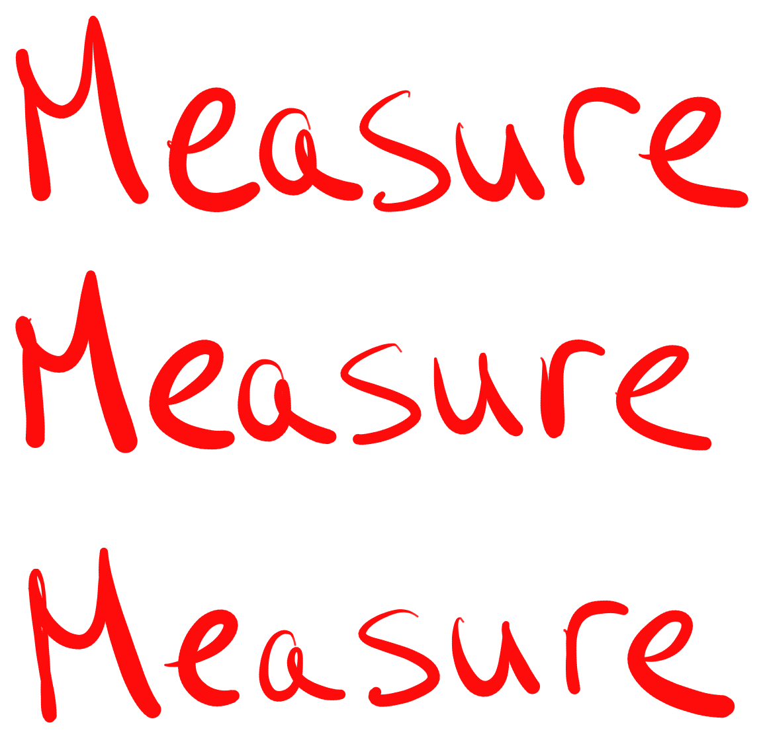
@jeremybytes
Notes:
Measure Measure Measure

Slide 51

@jeremybytes
Notes:
Resources

Slide 52


@jeremybytes
Notes:
Parallel Programming with Microsoft .NET

Slide 53
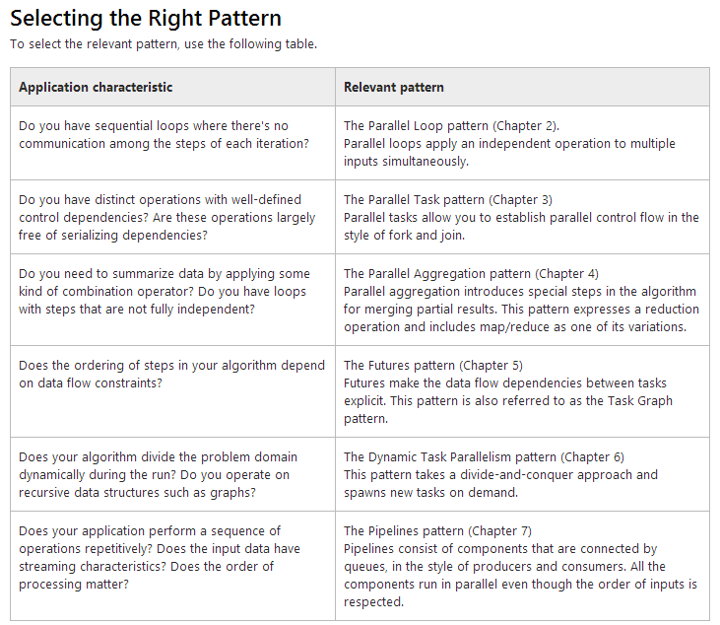
@jeremybytes
Notes:
Parallel Programming with Microsoft .NET
Chart: Selecting the Right Pattern
This is from the "Introduction" available here: https://docs.microsoft.com/en-us/previous-versions/msp-n-p/ff963542(v=pandp.10)#design-approaches

Slide 54
GitHub https://github.com/jeremybytes/parallel-programming
Parallel Programming w/ Microsoft .NET https://docs.microsoft.com/en-us/previous-versions/msp-n-p/ff963553(v=pandp.10)
Task & Await http://www.jeremybytes.com/Demos.aspx#TaskAndAwait
Presentation Links http://www.jeremybytes.com/Demos.aspx#RunFaster
@jeremybytes

Slide 55


@jeremybytes
Notes:
Thank You
Website: jeremybytes.com
Twitter: @jeremybytes

